Slide 1


Welcome to the Foundation Stage and Year one Reading and Phonics Workshop

Slide 2

Research says…….
Your child is more likely to get good exam results, go to university earn a good salary and have better mental health if:
They are supported at home with their language development, (listening, speaking, reading and writing).
Children that are regularly read to have more sophisticated vocabulary.
Children with a good vocabulary will be better readers and writers and be able to access all areas of the curriculum (will know 32 million more words at the age of 4)

Slide 3

BookTrust- reading with children
Research indicates a strong positive relationship between the frequency of book sharing and children’s language and literacy development, attainment at school, and well-being.
Evidence shows that
reading 3-5 days per week has the same effect on a child's reading skills at age 4-5 as being six months older.
reading 6-7 days per week has the same effect as being almost 12 months older (Kalb et al, 2012).
Further evidence also indicates that children of all backgrounds who were read to regularly by their parents at age 5 performed better in maths, vocabulary and spelling at age 16 than those who were not read to (Sullivan and Brown, 2013).

Slide 4
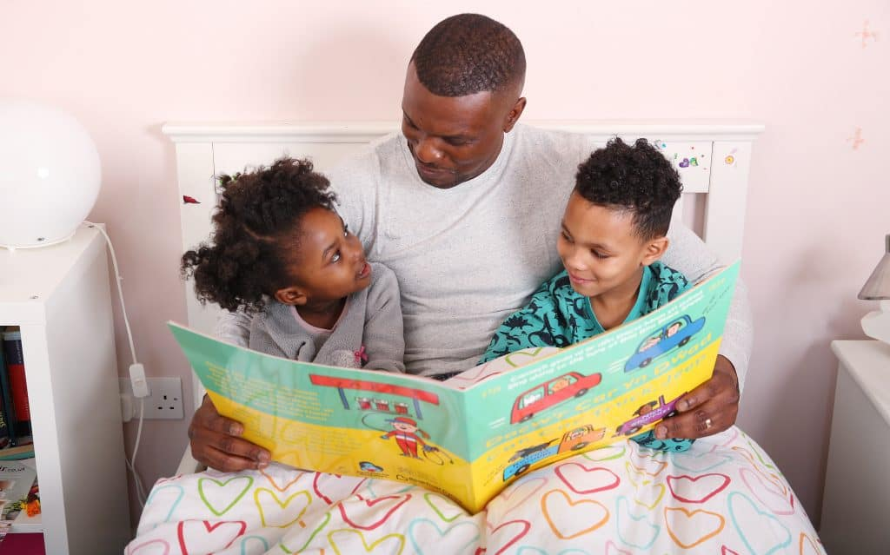
Alison David - Help Your Child Love Reading
“There are so many wonderful things that reading for pleasure brings to children beyond academic success: comfort and reassurance, confidence and security, relaxation, happiness and fun. It feeds their imagination, helps them to empathise, it even improves their sleeping patterns. And reading is a really important element of family life. It provides a connection between you and your child from the very early days through to teens and beyond. It’s a strong ‘glue’ for your relationship, bringing you closer together through the sharing of reading and stories. It helps build strong family ties and provides a shared set of stories and experiences which are unique to your family.”

Slide 5
Number of words
How many words children would have heard by the time they were 5 years old:
Never read to, 4,662 words
1-2 times per week, 63,570 words
3-5 times per week, 169,520 words
daily, 296,660 words
five books a day, 1,483,300 words
Jessica Logan, lead author of the study and assistant professor of educational studies at The Ohio State University.

Slide 6


Slide 7
Phonics Terminology
Phoneme – sound. These must be said clearly.
Grapheme – written representation.
GPC – Grapheme phoneme correspondence.
Segment – break the word apart e.g cat c-a-t.
Blend – put sounds/phoneme together to make the word
e.g c-a-t cat.
Digraph – 2 letters that represent 1 sound e.g ck, ch, sh.
Trigraph – 3 letters that represent 1 sound e.g igh, ear, air.
Common Exception Words (CEW)– words that cannot be segmented or blend using phonics. Sometimes known as tricky words, look and say or irregular words.
Vowel and consonants VC – up, it CVC- dog, mug CVCC – tent CCVC - stop, spoon, bring CCVCC - trust, crept CCCVC – street, spring.
Syllable – a unit of organisation for a sequence of speech sounds e.g Max- 1 syllable Leon- 2 syllables Savannah- 3 syllables Alexander- 4 syllables we encourage the children to clap the syllables in their name and other words.

Slide 8

Phonics Scheme
At Eastover we follow Unlocking Letters and Sounds to teach phonics.
There are 6 phases from Nursery to Year 2.
In each lesson the children go over all GPC’s and CEW’s learned already. Then they will learn new ones and apply in reading and writing.

Slide 9
Phase 1 - Nursery
There are 7 aspects within phase 1. The main focus is to tune children into listening to the various sounds around them, such as:
Environmental sounds, musical sounds, speech sounds (rhyme and alliteration).
Aspect 7 within Phase 1 teaches children to listen through a simple CVC word. When children can do this, they are Phase 2 ready. This is crucial to reading success.

Slide 10
Phase 2 – 6 weeks
Children will learn 23 phonemes in this phase:
s, a, t, p, i, n, m, d, g, o, c, k, ck, e, u, r, h, b, l, f, ff, ll, ss. (it is essential that these are pronounced correctly).
It is important that children learn these phonemes to enable them to blend to read and segment to spell.
There are also Common Exception Words (CEW) to learn in this phase!
the, I, no, go, into

Slide 11
Phase 3 – 12 weeks
A further 25 phonemes are learnt in this phase:
j, v, w, x, y, z, zz, qu, ch, sh, th, ng, ai, ee, igh, oa, oo, ar, or, ur, ow, oi, ear, air, ure and er.
These are used in the same way as Phase 2 for blending and segmenting.
There are also more Common Exception Words(CEW) to learn in this phase.
she we he be my you was all they

Slide 12
Phase 4 12 weeks in FS and 6 in Year 1
In Phase 4 no new GPC’s are learned.
The purpose of this phase is to consolidate children’s knowledge of graphemes in reading and spelling words containing adjacent consonants and polysyllabic words.
New Common Exception Words (CEW) to learn
said, have, like, so do, some, come were, there, little, one, when, out, what

Slide 13
Phase 5 – Year 1
This phase consists of new graphemes and alternative pronunciations for these and spellings. There are 3 stages 5a, 5b and 5c.
5a Children learn alternative ways of writing phonemes already learned e.g ay (ai) and ie (igh)
5b Children learn alternative pronouciations e.g. ow “snow”
5c Children learn alternative spellings of known phonemes e.g. ch “picture.”
Book marks that your child brings home to read are Phase 5 words.
More CEW’s to be learned
people Mr Mrs looked called asked water where who thought through mouse work many laughed when because what any eyes friends once please school

Slide 14
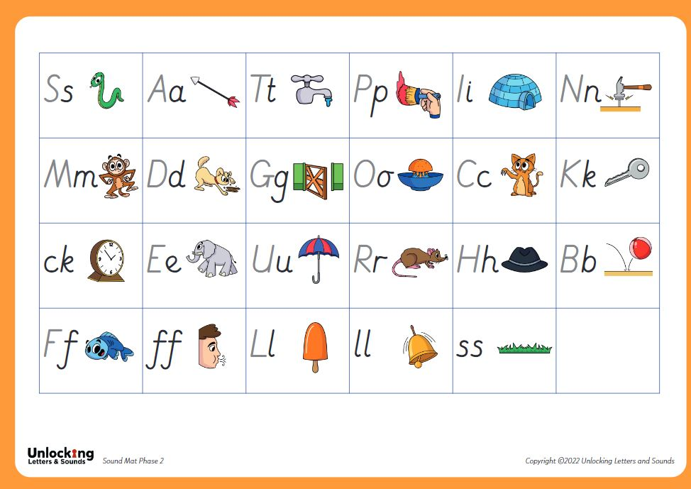
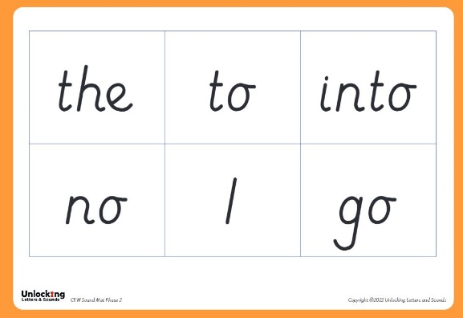
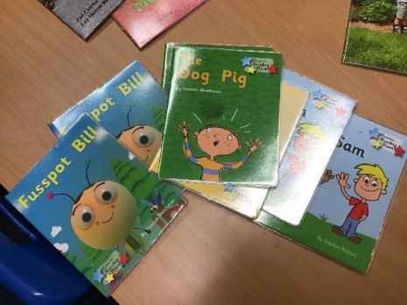
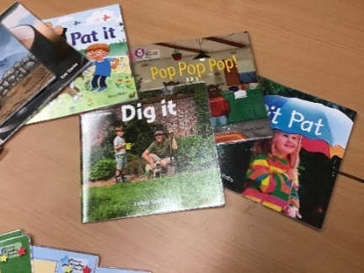
What your child will be bringing home!
4 sounds/phonemes taught a week and each child has a sound mat to help you learn these at home. There are QR codes in the reading record to access this.
When we feel your child is confidently blending sounds together keyword cards will be sent home. These have de-codable words and 1 or 2 Common Exception Words in bold or starred
Children will reach these stages at varying rates.
Schemed reading books that your child should be able to read to you using the phonic skills they’ve been taught.

Slide 15
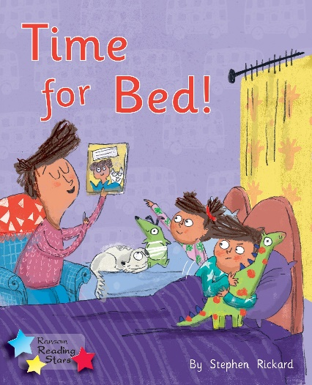
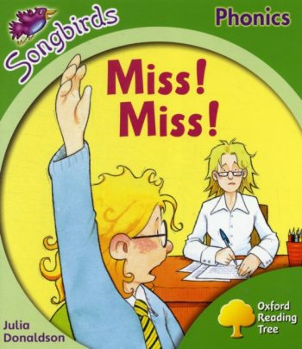
Home School phonics schemed reading books
When your child has a bank of keywords they will have a schemed reading book to read at home. It is expected that your child reads this book as it will match what they have learned in phonics.
Your child will need to read this book 3 times in the week, the first will be to decode which will take time, the second hopefully they will read with more fluency relying less on blending each word and the third time with expression to show engagement and understanding of the text.

Slide 16

We will look in the Reading Record’s each week to check keywords and comments for how they have coped with reading. Only when the book has been signed/ commented on will we change the reading book.
Children are rewarded in school for reading at home. This information is in their reading records and was discussed at the welcome meeting.

Slide 17
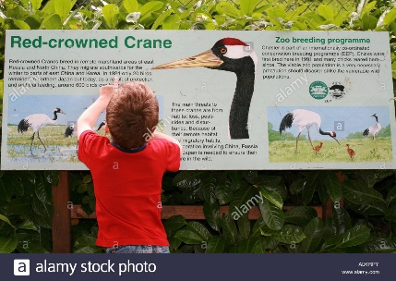

How you can help at home
‘Real, choosing, library’ books are equally important to share with your child on a daily basis if possible. Your child will choose books each week to share with you at the present time. They are not expected to be able to read these but to share with an adult and enjoy.
Choose the right time for you and your child!!
Little and often is better than none at all.
If you can practice phonics and keyword picture cards every day.
Please keep us up dated in the Reading Record or if you have any serious concerns please let a member of staff know.
Notice and celebrate when your child uses their phonic/letter knowledge in the real world!
Allow your child to see you reading.
Visit the library.
They don’t have to just read a reading book- magazines, newspapers, shopping lists, birthday cards, signs, leaflets…

Slide 18
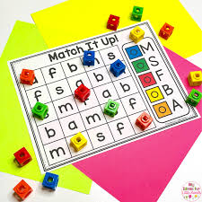
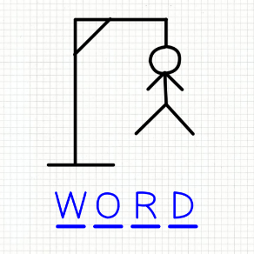
Games to play to support reading
These games can be used to support look and say word recognition or to learn the key word cards.
Flash Cards - use them to “flash & read” with your child.
Snap-use two sets to play snap
Matching Pairs Game-Lay the cards face down, turn over two at a time, if they match make a pair. Keep going till all cards are gone.
Word Collage - Find the words in newspapers and magazines and make a word collage (keep a scrapbook!)
Play stepping stones - place words on the floor and children walk over them saying the word as they go to the other side of the room.
Make words using magnetic letters
Highlighter – give your child a highlighter and ask them to highlight a chosen sight word. How many times can you find it?
Flashlight words – turn off lights – flash a torch on words on display for look and say (good before bed!)
Nought and crosses/Hug and kisses – select words to lay out in a 9x9 grid take turns to choose one and read and place your o x
Hangman- guess the letters that the word contains.

Slide 19
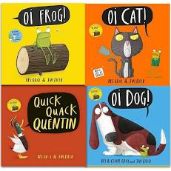
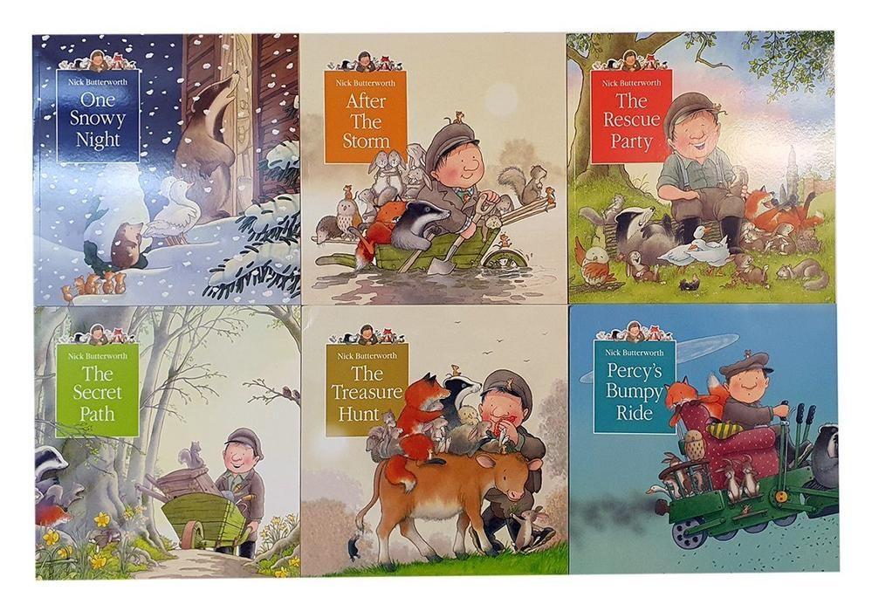

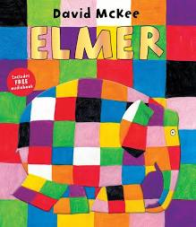


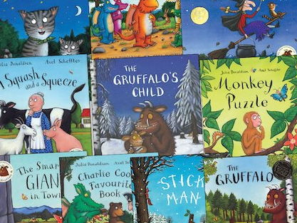

Books

Slide 20

Thank you for coming!
We hope you have found it useful.

