Slide 1

Welcome to Year 5

Slide 2
Attendance
Gates open at 8:35
School registration is at 8:45
Pick up at 15:10.
Parental permission can be given to allow children to walk home independently.
Phones can be brought in, held by teachers until the end of the day.

Slide 3
Uniform
Grey skirt/pinafore dress
Smart grey trousers or tailored shorts
White polo shirt
Red sweatshirt / cardigan
White socks
Sensible black shoes with low heels to give firm support or for the summer plain white sensible sandals with enclosed toes.
Hair should be tied back and cut neatly. It must not be tinted or coloured.
All clothing should be clearly marked with your child’s name.

Slide 4
PE kit
Children have PE on Mondays
Red T-shirt (plain)
Black shorts
Black trainers
White socks
Black tracksuit bottoms (in colder weather)
No brands/logos
All clothing should be clearly marked with your child’s name.

Slide 5
Homework expectations
15 minutes on Times Tables Rockstars, three times a week. – Can be completed between 7:00am and 8:00pm.
1 play through of set task everyday on Emile.
Reading will take place in school every morning. If they read at home, there is no need to record this.
Reading records kept in school, passwords will be sent home.

Slide 6
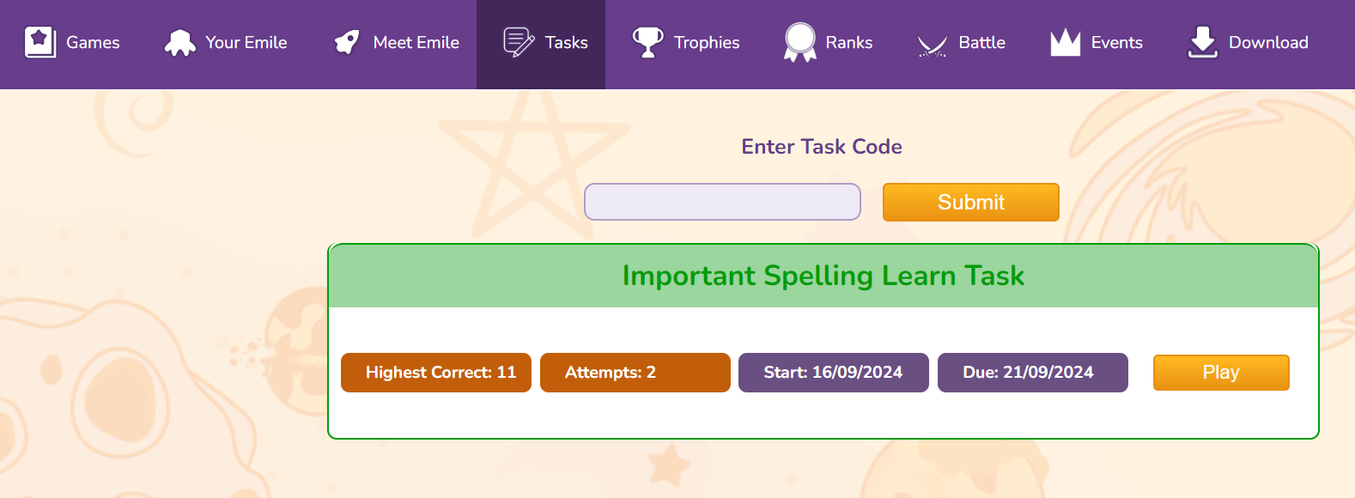
Emile
Children are set a new task every week, this needs to be practiced
everyday as these are the week’s spellings.

Slide 7
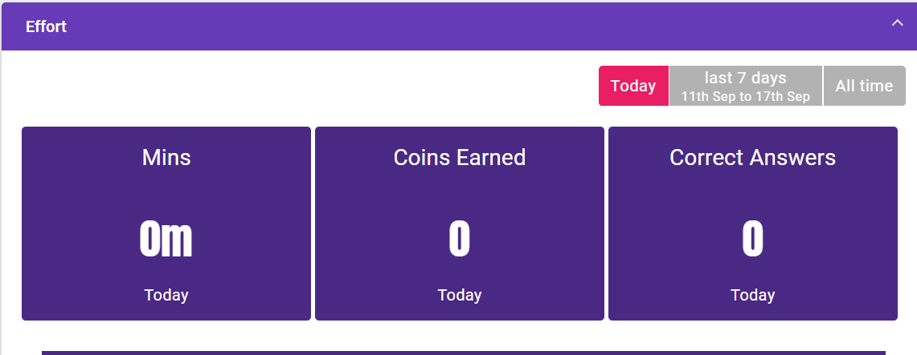
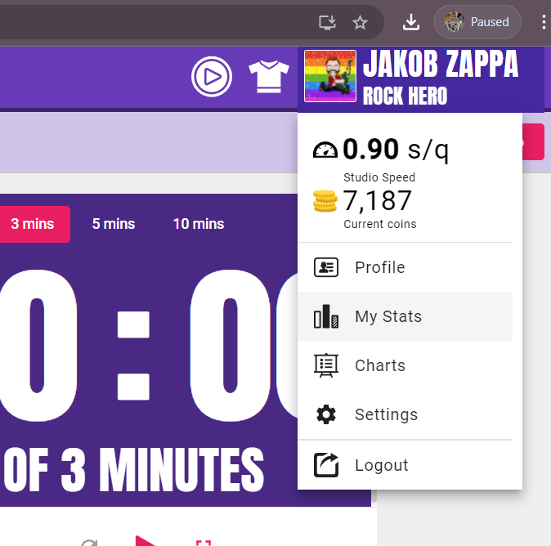
TTRockstars
Children can view how many minutes they’ve completed by
clicking their username, my stats and then see their daily total.
It’s fifteen minutes of practice, not fifteen minutes on the app.

Slide 8
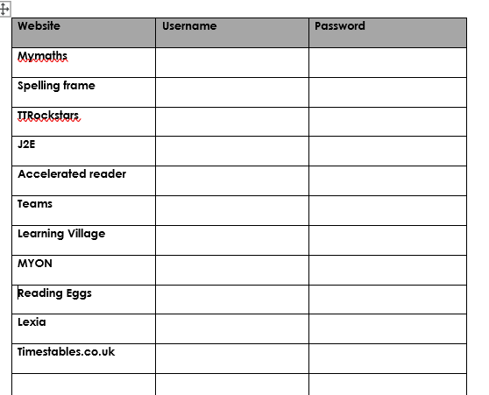
Passwords
All passwords will be sent home.

Slide 9
Curriculum
All links to the curriculum and children’s learning can be found on the Giraffe and Kangaroo class page.
This is found under the pupil section on the school website.

Slide 10
Communication
white boards outside the classrooms
school bulletin each Friday
reading records
Facebook
school website – www.eastoverschool.co.uk
Email:
pwarren@eastoverschool.co.uk
llukins@eastoverschool.co.uk
Talk to us at the end of the school day
Call the office and ask us to call you

Slide 11
Any questions?

Slide 12

Residential

Slide 13
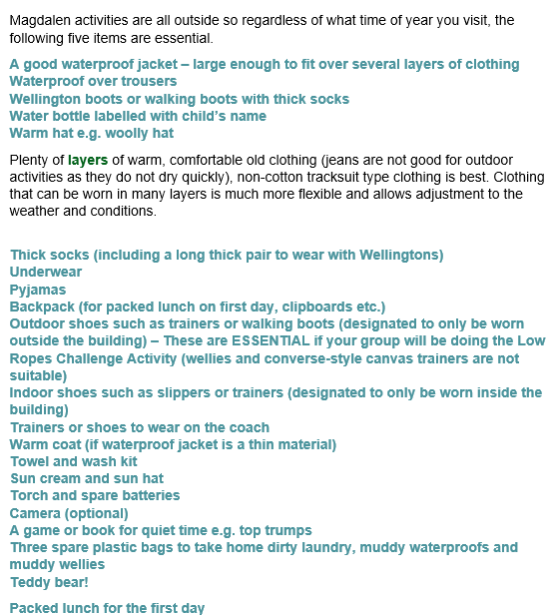
Kit List
No mobile phones

Slide 14
Residential

Slide 15
Activities
Orienteering
Teambuilding activity
Dinner and Campfire
Farming – Chickens
Hands on Farming morning
Survival in the wild
Eco Cooking Pizza and smoothie bikes

