Slide 1

Welcome to Year 3

Slide 2
Attendance
Gates open at 8:35
School starts at 8:45
No authorised holidays unless exceptional circumstances.

Slide 3
Uniform
Grey skirt/pinafore dress
Smart grey trousers or tailored shorts
White polo shirt
Red sweatshirt / cardigan
White socks
Sensible black shoes with low heels to give firm support or for the summer plain white sensible sandals with enclosed toes.
Hair should be tied back and cut neatly. It must not be tinted or coloured. It must not have tram lines, shorter shaven areas or a mohican style cut.
All clothing should be clearly marked with your child’s name.

Slide 4
PE kit
Children have PE on Fridays.
Red T-shirt (plain)
Black shorts
Black trainers
White socks
Black tracksuit bottoms (in colder weather)
No brands/logos
All clothing should be clearly marked with your child’s name.

Slide 5
Swimming
Swimming starts on Monday 8th September until Monday 13th of October.
Children to wear PE kits on swimming days.
They will have a second block after Christmas.
Please make sure that all swimming kit e.g. costumes, uniform and towels are clearly labelled with your child’s name.

Slide 6
Snack time
In KS2 fruit is often available on the playground, but we suggest if you are able to please provide a healthy snack.

Slide 7
Homework expectations
We expect the children to read daily
Homework should be a mixture of reading, spelling practice and times tables.
All reading should be recorded in the child’s homework diary. Please write the page numbers read and sign.

Slide 8


How to support your child with reading
Enjoy books together.
Share favourite stories, comic, non-fiction or magazines. Discuss what happened in the text or what you think could happen. Try and make reading a part of your day.

Slide 9
AR
In year 3 all children use Accelerated Reader as our main reading scheme. Their reading ages are tested half termly to ensure they are making progress.
Children will quiz on their books in school and will have the chance to do this most days as required.
To start off with we suggest that some children read the book more than once so they are familiar with the story in preparation for quizzing.
Your child needs to score 80% or above to progress to the next level in the scheme.

Slide 10
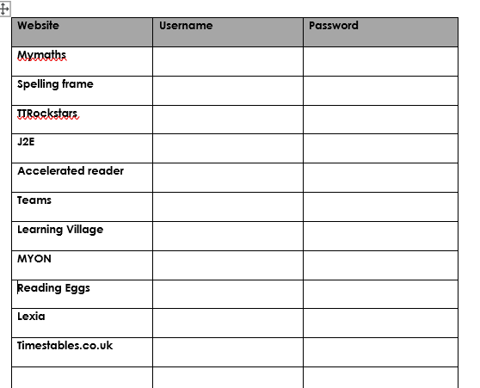
Passwords
All passwords are in reading records

Slide 11
Curriculum
All links to the curriculum, knowledge organisers and children’s learning can be found on Lions and Tigers class page.

Slide 12
Communication
white boards outside the classrooms
school bulletin each Friday
reading records
Facebook
school website – class pages: https://www.eastoverschool.co.uk/year-3-lion-tiger-class/
Email: jmarsh@eastoverschool.co.uk lweall@eastoverschool.co.uk
Talk to us at the end of the school day
Call the office and ask us to call you

Slide 13
Thank you for coming!
Any questions please come and see us ☺

