Slide 1

Welcome to Year 4

Slide 2
Attendance
Gates open at 8:35
School starts at 8:45
No authorised holidays unless exceptional circumstances.

Slide 3
Uniform
Grey skirt/pinafore dress
Smart grey trousers or tailored shorts
White polo shirt
Red sweatshirt / cardigan
White socks
Sensible black shoes with low heels to give firm support or for the summer plain white sensible sandals with enclosed toes.
Hair should be tied back and cut neatly. It must not be tinted or coloured. It must not have tram lines, shorter shaven areas or a mohican style cut.
All clothing should be clearly marked with your child’s name.

Slide 4
PE kit
Children have PE on Tuesdays.
Red T-shirt (plain)
Black shorts
Black trainers
White socks
Black tracksuit bottoms (in colder weather)
No brands/logos
All clothing should be clearly marked with your child’s name.

Slide 5
Swimming
We will be swimming from Monday 20th October- Monday 1st December (block 1).
Then again from Monday 23rd March- Monday 18th May (block 2).
Children need to wear PE kit on these days
Swimming kit
Towel
Goggles if possible
Named

Slide 6
Homework expectations
We expect the children to read daily
Homework should be a mixture of reading, spellings (Emile) and times tables (TT Rockstars).
10 mins for each.
All reading should be recorded in the child’s homework diary. Please write the page numbers read and sign.

Slide 7


How to support your child with reading
Enjoy books together.
Share favourite stories, comic, non-fiction or magazines. Discuss what happened in the text or what you think could happen. Try and make reading a part of your day.

Slide 8
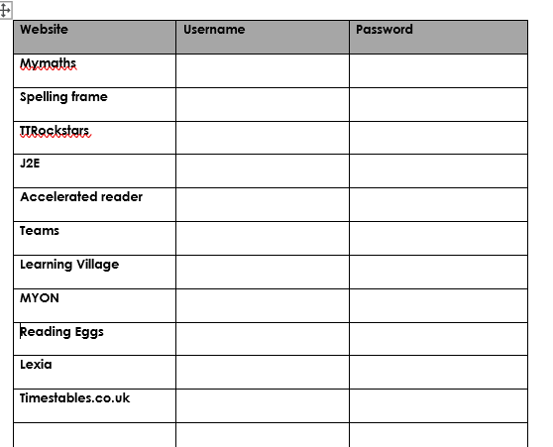
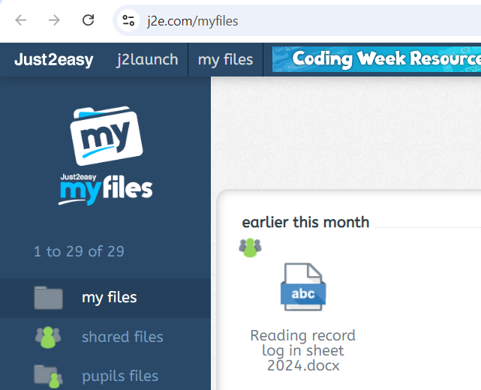
Passwords
All passwords will be in reading records.
Also on J2E.

Slide 9
Curriculum
All links to the curriculum, knowledge organisers and children’s learning can be found on Seals and Dolphins class page.

Slide 10
Communication
white boards outside the classrooms
school bulletin each Friday
reading records
Facebook
school website – class pages: https://www.eastoverschool.co.uk/page/?title=Year+4+%2D+Seal+%26amp%3B+Dolphin+class&pid=95
Email: mpierzchalska@eastoverschool.co.uk
jfleet@eastoverschool.co.uk
Talk to us at the end of the school day
Call the office and ask us to call you

Slide 11
Thank you for coming!

