Slide 1

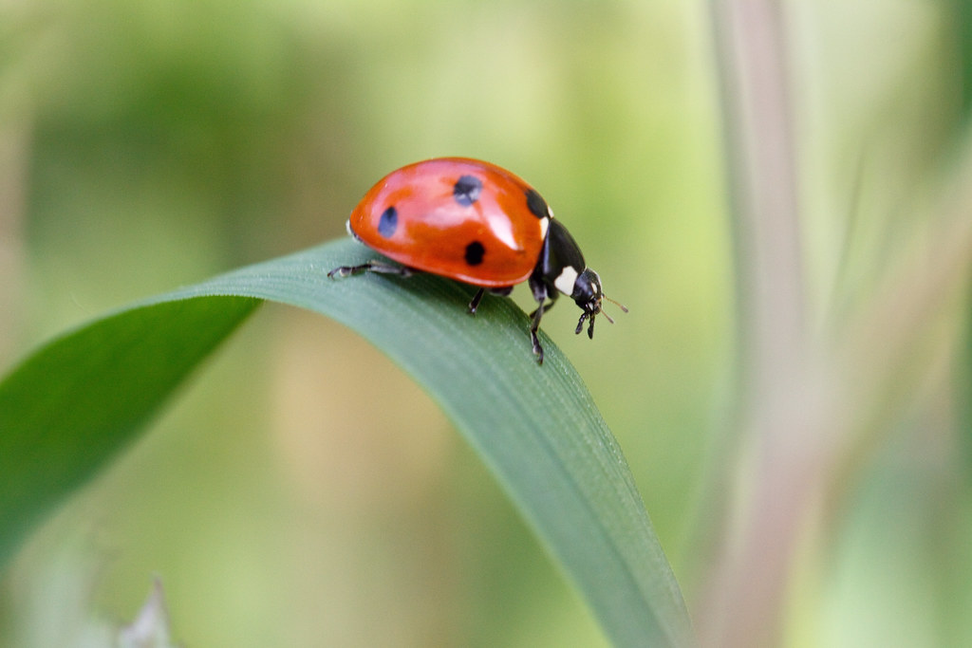
Welcome to Ladybird Class

Slide 2
Attendance
Gates open at 8:35
School starts at 8:45
No authorised holidays unless exceptional circumstances.

Slide 3
Uniform
Grey skirt/pinafore dress
Smart grey trousers or tailored shorts
White polo shirt
Red sweatshirt / cardigan
White socks
Sensible black shoes with low heels to give firm support or for the summer plain white sensible sandals with enclosed toes.
Hair should be tied back and cut neatly. It must not be tinted or coloured. It must not have tram lines, shorter shaven areas or a mohican style cut.
All clothing should be clearly marked with your child’s name.

Slide 4
PE kit
Children will have PE on a Friday.
Red T-shirt (plain)
Black shorts
Black trainers
White socks
Black tracksuit bottoms (in colder weather)
No brands/logos
All clothing should be clearly marked with your child’s name.

Slide 5
Change of details and contacts
Please update any contact details – addresses, telephone numbers etc on SIMS parent asap.
Or call in to the school office.

Slide 6
School Lunches
All children in Foundation Stage, Year One and Year Two are entitled to a free school lunch.
Please make sure you have ordered these each week otherwise a lunch cannot be provided.
If you wish to provide a packed lunch then please send in a labelled lunchbox and this must include a healthy lunch.

Slide 7
Homework expectations
We expect the children to read daily.
Homework should be a mixture of reading, practising phonemes and practising reading keyword cards.
All reading should be recorded in the child’s homework diary. Please write the page numbers read and sign.

Slide 8


How to support your child with reading
Enjoy books together.
Share favourite stories, comic, non-fiction or magazines. Discuss what happened in the text or what you think could happen. Try and make reading a part of your day.

Slide 9
Passwords
All passwords will be in reading records when we assign them e.g Numbots.

Slide 10
Curriculum
All links to the curriculum and children’s learning can be found on Ladybirds and Butterflies class page.
We will have further phonics workshops and maths workshops this term so you can help support your child at home.

Slide 11
Communication
Seesaw
school bulletin each Friday
reading records
Facebook
school website
Talk to us at the end of the school day
Call the office and ask us to call you

Slide 12
Thank you for coming!

