Slide 1


Year Two
Phonics Screening Check
A Guide for Parents

Slide 2
Chapters
1
What is Phonics?
2
What is the Phonics Screening Check?
3
What Happens During the Screening?
4
Pseudo Words (Nonsense words)
5
Reporting to Parents
6
How Are the Results Used?
7
How Can I Help My Child at Home?
next page

Slide 3

What is Phonics?
Children begin to learn phonics (sounds) in early years, both nursery and reception. Once children begin learning sounds, these sounds are used orally to identify and make words. They will then begin to learn the letters which make each of the sounds and these are used to read and spell words.
Once children begin learning sounds, these sounds are used orally to identify and make words. They will then begin to learn the letters which make each of the sounds and these are used to read and spell words.
chapter
menu
next page

Slide 4

What is the Phonics Screening Check?
Normally, children in Year 1 throughout the country take part in a phonics screening check during the same week in June. Children in Year 2 also take the check if they did not achieve the required result when in Year 1 or they have not taken the test before.
Any children who do not achieve the required test result will re take the phonics screening assessment in June.
chapter
menu
next page

Slide 5

What Happens During the Test?
The test contains 40 words. Each child will sit one-to-one and read each word aloud to a teacher. The test will take approximately 10 minutes per child, although all children are different and will complete the check at their own pace. The list of words the children read is a combination of 20 real words and 20 pseudo words (nonsense words).
chapter
menu
next page

Slide 6

Pseudo Words (Nonsense Words)
The pseudo words will be shown to your child with a picture of an alien. This provides the children with a context for the pseudo word which is independent from any existing vocabulary they may have. Pseudo words are included because they will be new to all pupils; they do not favour children with a good vocabulary knowledge or visual memory of words.
chapter
menu
next page

Slide 7
How Can I Help My Child at Home?
Play lots of sound and listening games with your child.
Read as much as possible to and with your child.
Encourage and praise – get them to have a ‘good guess’.
If your child is struggling to decode a word, help them by encouraging them to say each sound in the word from left to right.
Blend the sounds by pointing to each one, e.g. /c/ in cat, /p/ in pat, /ng/ in sing, /ee/ in been. Next move your finger under the whole word as you say it.
Discuss the meaning of words if your child does not know what they have read.
chapter
menu
next page

Slide 8
How Can I Help My Child at Home?
We have added a few resources onto our class page that you can use with your child.
    Pseudo words – read these words with your child. Encourage them to sound them out. If your child is struggling then you can write the words with them and add sound buttons to help them see the separate sounds (see the next slide).
    Real and nonsense words power point – read the words with your child. Discuss the meaning of any real words.
    Phase 3 and 5 flash cards – practise the sounds as often as you can with the children. Make it a game, how quickly can they say the sounds?
chapter
menu
next page

Slide 9
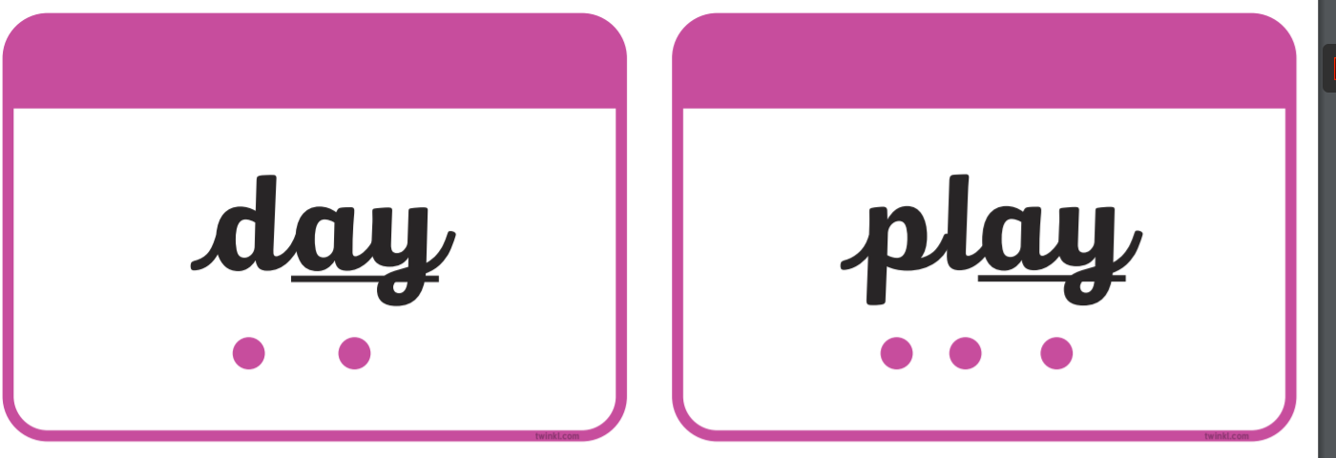
Sound buttons
A dot for a single sound (phoneme)
A line for one sound represented by two or more letters.
chapter
menu
next page

