Slide 2
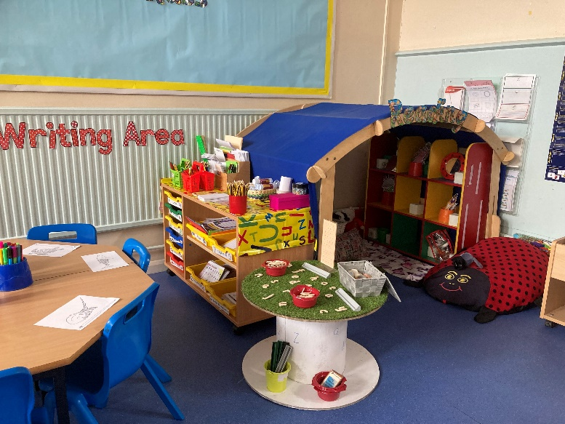
What Is the EYFS?
The Early Years Foundation Stage covers the first stage of a child’s care
from birth to five years old. It sets the standards to ensure that all children
learn and develop, as well as keeping them healthy and safe.
Also included in the EYFS are the seven Areas of Learning. They are:
  Communication and Language
  Personal, Social and Emotional Development
  Physical Development
  Literacy
  Mathematics
  Understanding the World
  Expressive Arts and Design
At the end of the EYFS, there are 17 Early Learning Goals that children are expected to achieve.

Slide 3
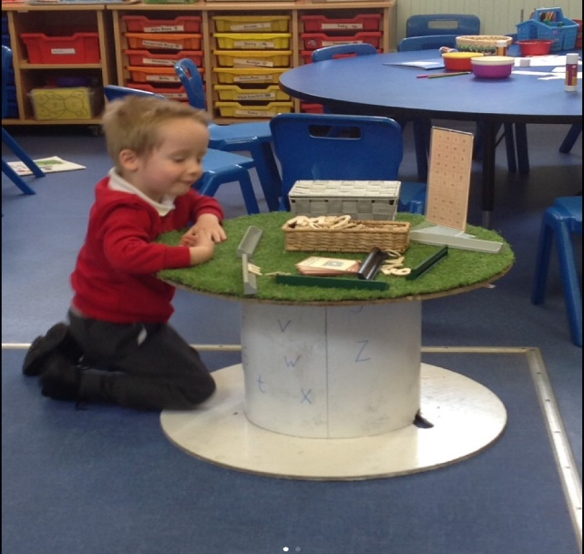
Why Have the Changes Been Made?
In 2019, the government proposed changes to the EYFS. These changes have now been made and all early years settings and schools will follow the new EYFS from September 2021.
The aim of the changes is to improve the learning for all children and better prepare them for the move into year 1.
To help make the right changes, evidence was looked at to find the best ways children can be supported in developing as they grow.
The changes also hope to give children the best start in life and set them up well for their future.

Slide 4
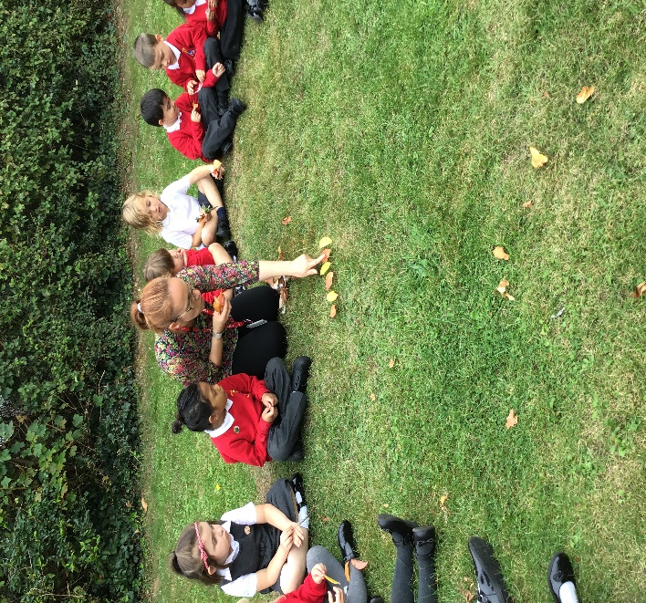
Some Key Changes
Reduced the amount of unneeded written recordings and assessment of children by staff.
This means staff do not need to keep a large amount of written evidence that proves children are able to do lots of things.
This frees up more time for staff to spend directly with the children.
By taking away the need for constant recording, it helps to develop more natural play, conversations and interaction between adults
and children.
A record of your child’s learning will be
recorded on Tapestry, in their work books
and class books.

Slide 5
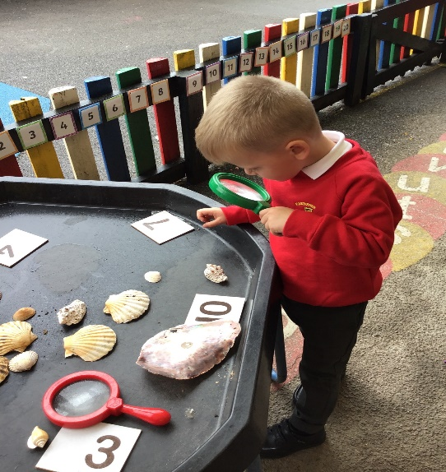
Some Key Changes
There is more of an emphasis on the importance of developing communication and language skills.
Children should be supported in building up vocabulary by increasing the amount of words they know and can use.
Encourage more conversations between adults and children, but also children and their peers.
Good language skills are the basis for all other learning and social interaction, so this is vital to focus on.
You will have been given a knowledge organiser to support children with new vocabulary at home.

Slide 6

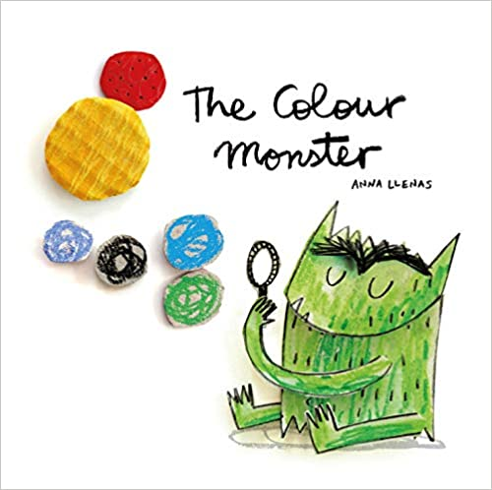
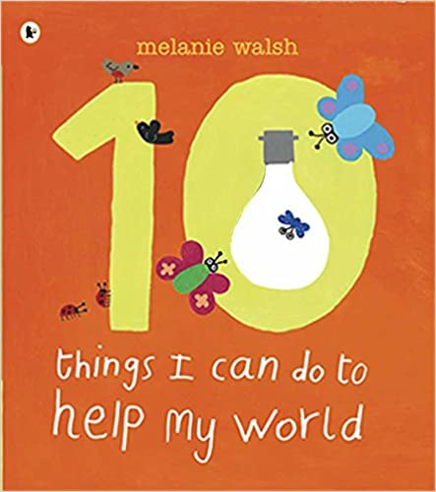
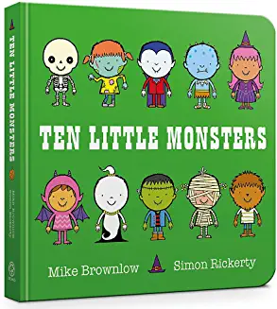
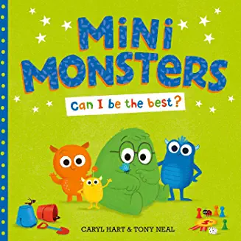
Some Key Changes
There is a focus on how reading stories is important to help children develop in all of Areas of Learning.
Daily reading of stories encourages an enjoyment of reading from a young age.
Lots of other learning opportunities happen when looking at books, for example comparisons of culture or the past.
Listening to stories develops imagination, ideas and language.
Reading is an essential skill and so should be shown to children, as well as practised by them regularly.
Children are also encouraged to use story ideas in their play.
A key story will also be added to your “Weekly Learning Review” every week to share with your child.

Slide 7


Some Key Changes
There is a focus on encouraging healthy choices overall and an understanding of oral health.
Required to teach children the importance of brushing teeth.
Focus on helping children to understand which choices to make that will help them to be healthy, for example which foods to eat and why.
Getting into good routines from a young age is important as these often continue into adult life.

Slide 8
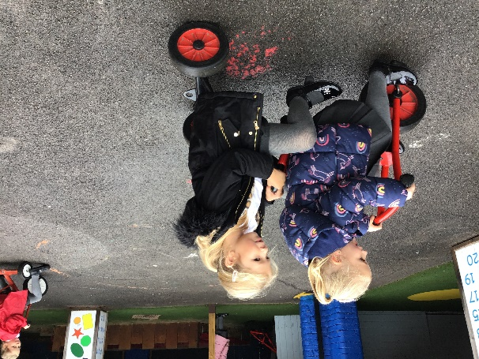
What Will This Look Like at
Eastover Primary?
How can I support my child at home?
Tapestry – share the photos with your child and get them to talk about their learning.
Learning Detectives – 3 children a day are chosen to be learning detectives and to share their ideas and learning with their class.
Weekly Learning Review – this will give you an insight into what has been happening in class and ideas for home too.
Achievosaurs – have you been a tryatops today?
Read, read, read – more about that next!

