Slide 1
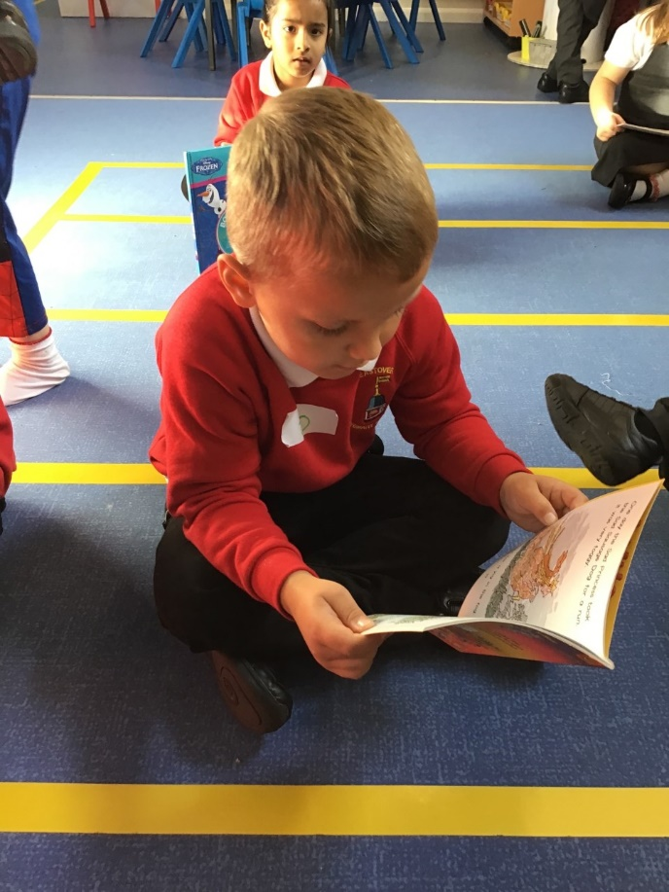

Literacy Workshop

Slide 2
Areas of Literacy
Reading
Speaking and Listening
Writing

Slide 3
Reading activity
Can you read this?
I cnduo't bvleiee taht I culod aulaclty uesdtannrd waht I was rdnaieg. Unisg the icndeblire pweor of the hmuan mnid, aocdcrnig to rseecrah at Cmabrigde Uinervtisy, it dseno't mttaer in waht oderr the lterets in a wrod are, the olny irpoamtnt tihng is taht the frsit and lsat ltteer be in the rhgit pclae. The rset can be a taotl mses and you can sitll raed it whoutit a pboerlm. Tihs is bucseae the huamn mnid deos not raed ervey ltteer by istlef, but the wrod as a wlohe. Aaznmig, huh?

Slide 4


So why are we together today?
To give you an understanding of phonics is taught and how you can help at home with phonics.
To give you ideas and advice on how best to support your child with reading and spelling.

Slide 5


Slide 6
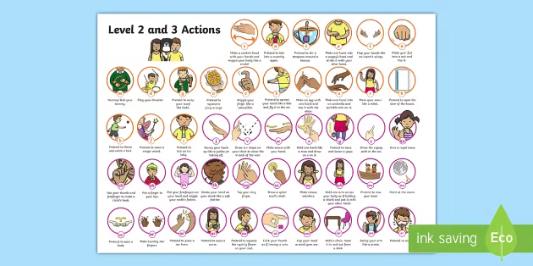
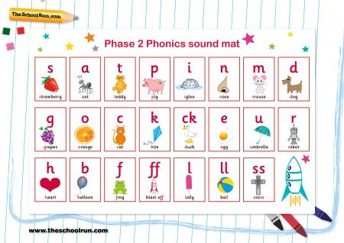
Phonics

Slide 7
Reading
‘Children are made readers on the laps of their parents’
Emilie Buchwald
Teaching reading: phonics
Shared reading
Group reading
Genres: Fiction, non-fiction, poetry
Individual reading books
Library books

Slide 8
Reading
Supporting your child at home …
Focus on letter sounds and names
Choose books that are interesting to your child
Provide a comfortable area for reading enjoyment
Set a routine time for reading that’s not assigned, eg. at bed time or after dinner.
Aim to read for 5 minutes 5 times a week with the school reading book.
Share the key stories with your child too.
Go to the library

Slide 9
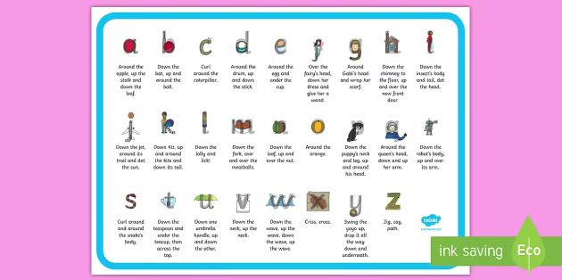
Writing
‘The act of writing brings with it a sense of discovery, of discovering on the page something you didn't know you knew until you wrote it.’
Charles Ghigna
Teaching writing: mark-making, experiment with letters, paints, chalks
Shared writing
Writing for a purpose
Different genres
Handwriting

Slide 10
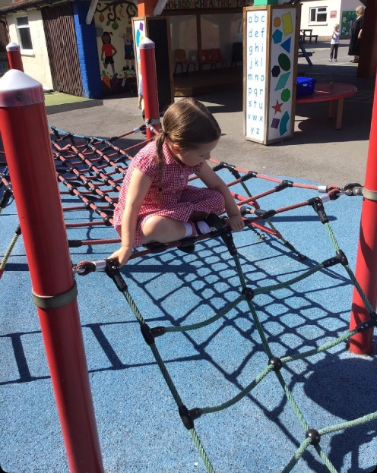
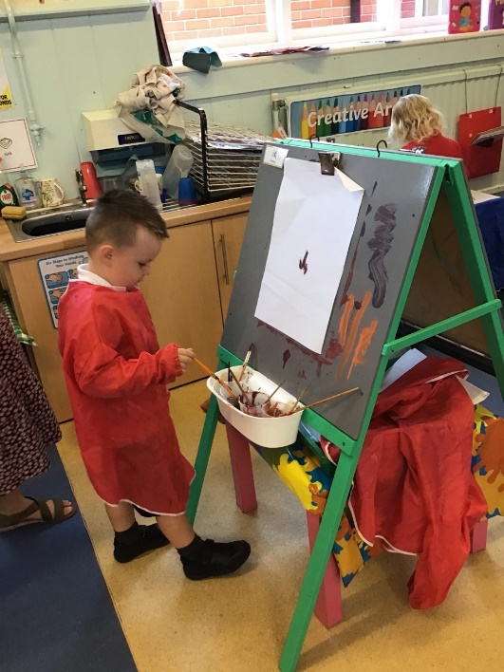
Writing
Encouraging your child to write at home …
Adult model writing (Shopping lists, invitations, cards)
Encourage child to make marks in sand, chalks, writing on the floor
Encourage use of lower case..

Slide 11
Thank you for coming

