Slide 1
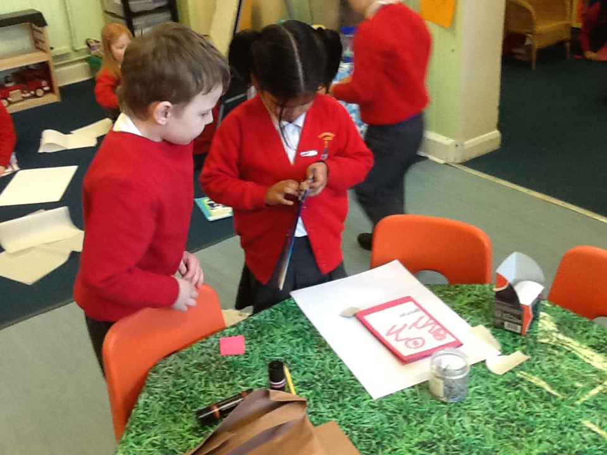
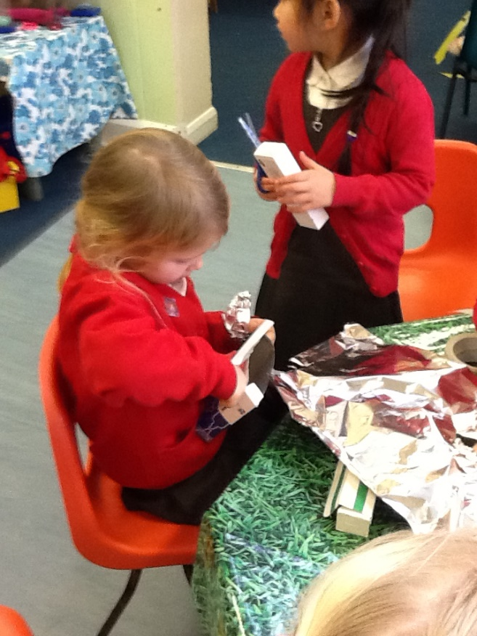
An Introduction to the EYFS

Slide 2
What is the EYFS?
EYFS stands for Early Years Foundation Stage.
There seven areas of learning and development and Early Learning Goals that children should reach at age 5, usually the end of the reception year.

Slide 3
The seven areas of learning
There are 3 Prime Areas of Learning and 4 Specific Areas of Learning.
The 3 Primes areas Personal, Social and Emotional Development, Communication and Language and Physical Development.
The 4 Specific areas are Literacy, Mathematics, Understanding the World and Expressive Arts and Design.
Within each area there are sub-areas which all add up to 17 areas altogether.
The development statements in months and their order should not be taken as necessary steps for individual children. They should not be used as checklists. The age/stage bands overlap because these are not fixed age boundaries but suggest a typical range of development.

Slide 4
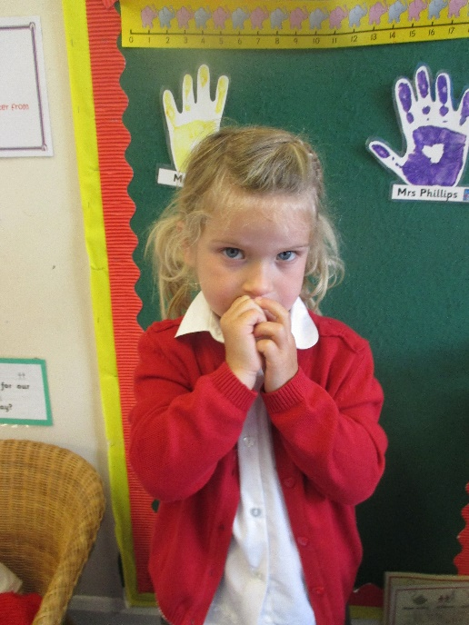
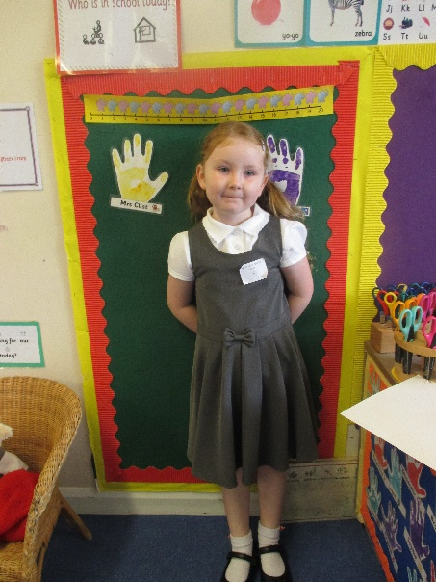
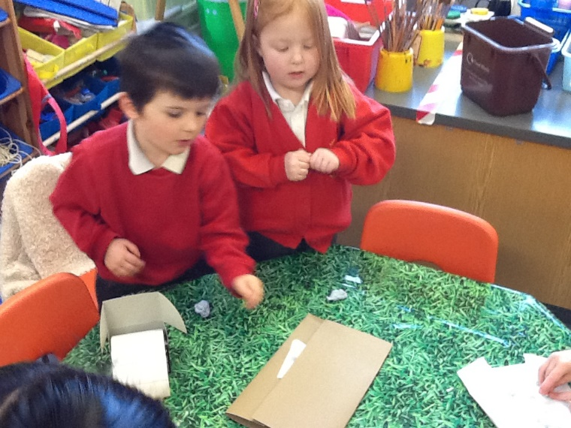
Personal, Social and Emotional Development
This prime area underpins all areas of learning. There are 3 areas within PSED are
Building Relationships
Self Regulation
Managing Self

Slide 5
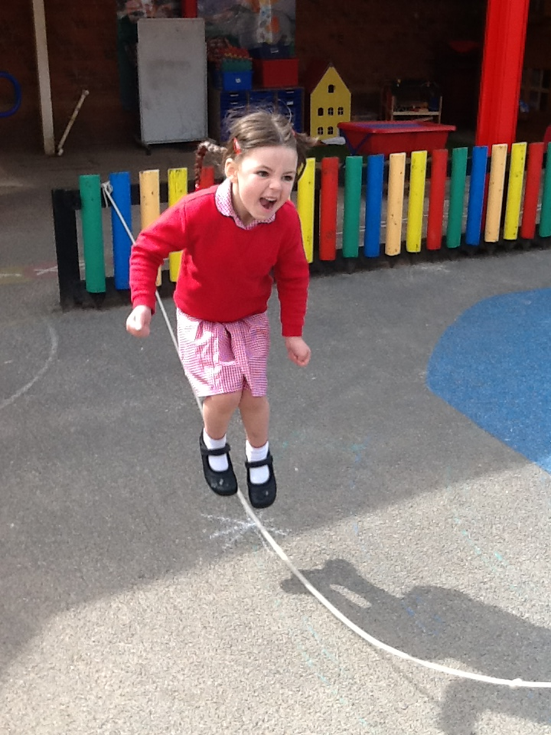
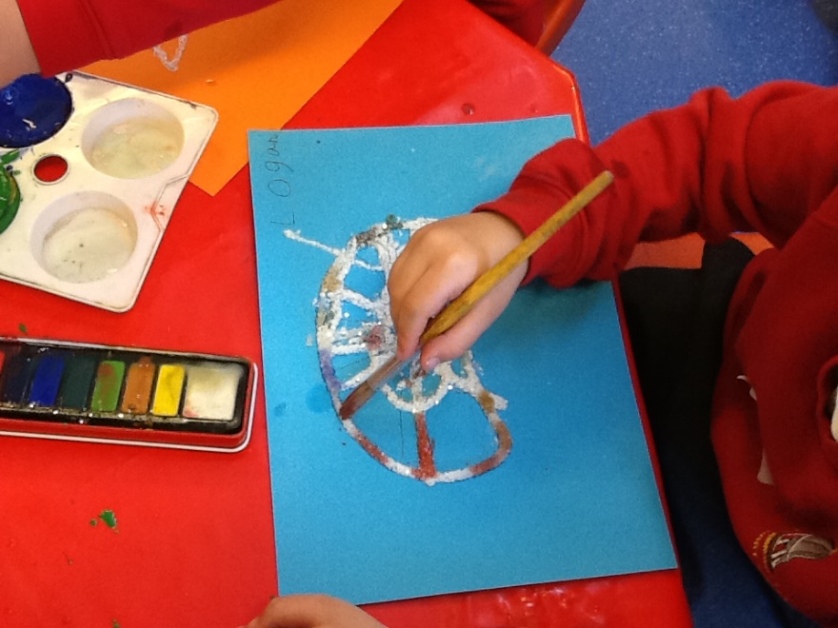
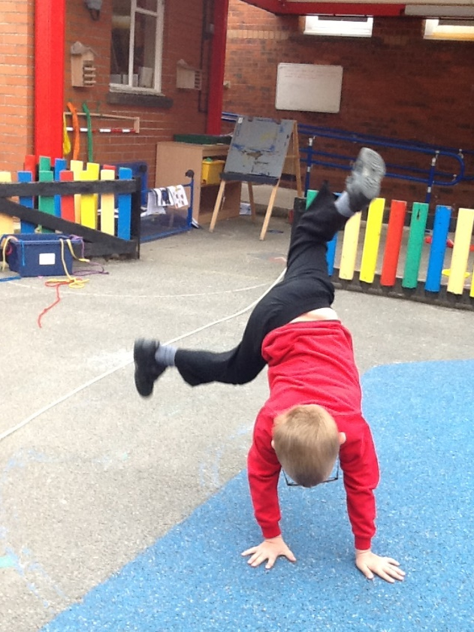
Physical Development
There are 2 areas of learning within Physical Development.
Fine Motor Skills
Gross Motor Skills

Slide 6
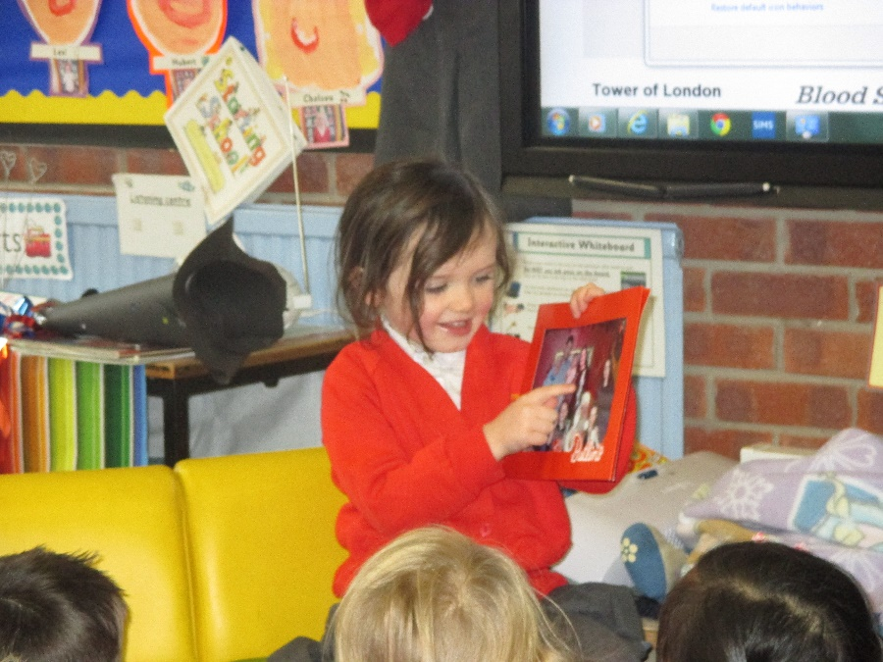
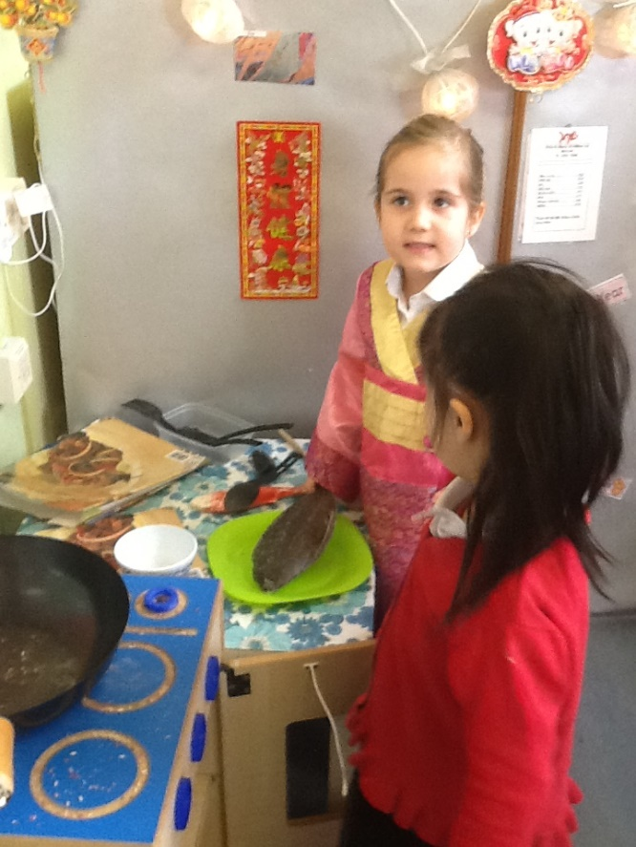
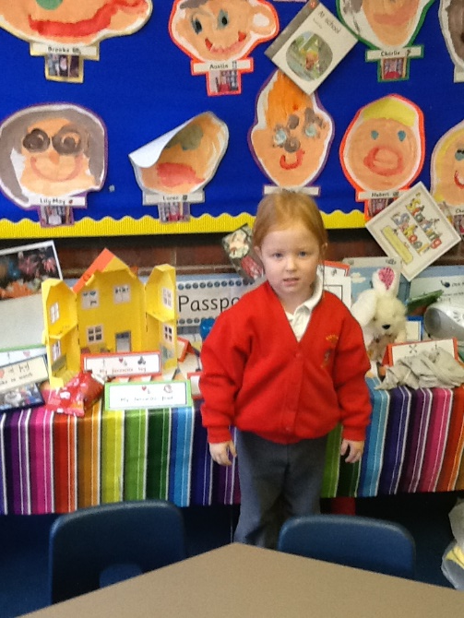
Communication and Language
Communication and Language includes 2 areas
Speaking
Listening and Attention

Slide 7
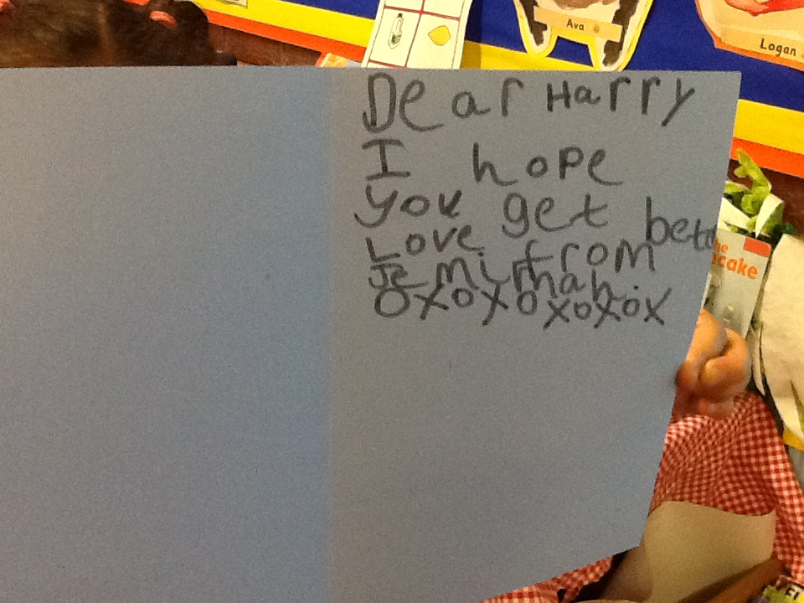
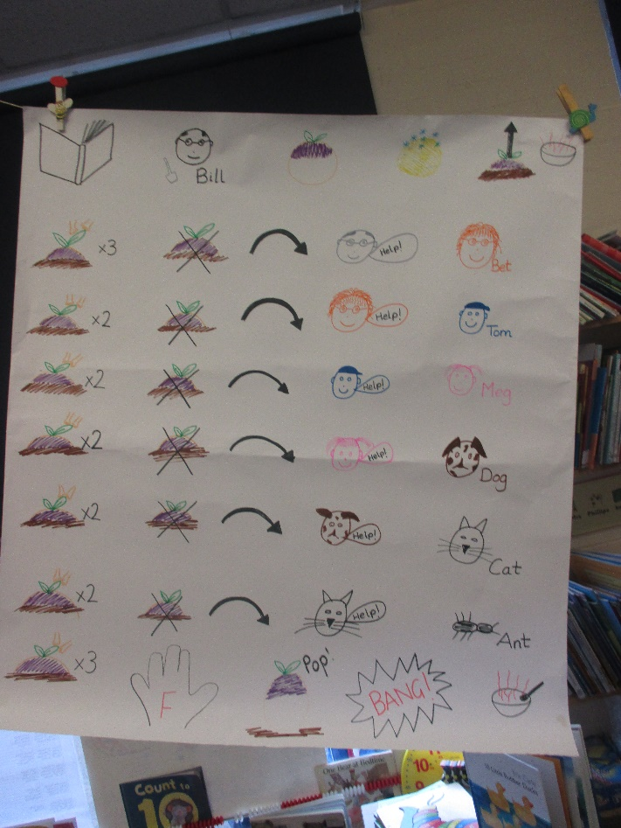
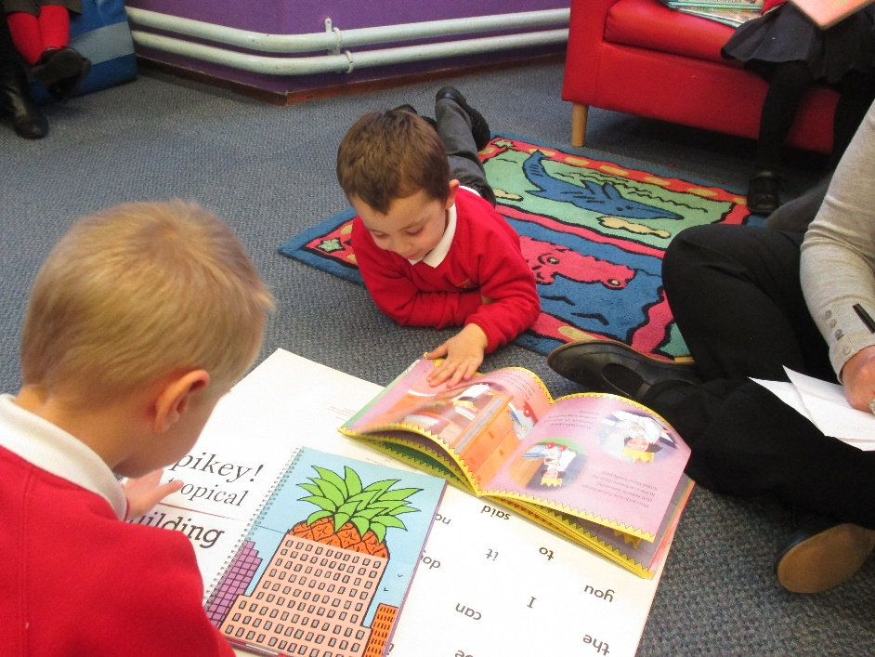
Literacy
Within Literacy are the areas of
Comprehension
Writing
Word Reading

Slide 8
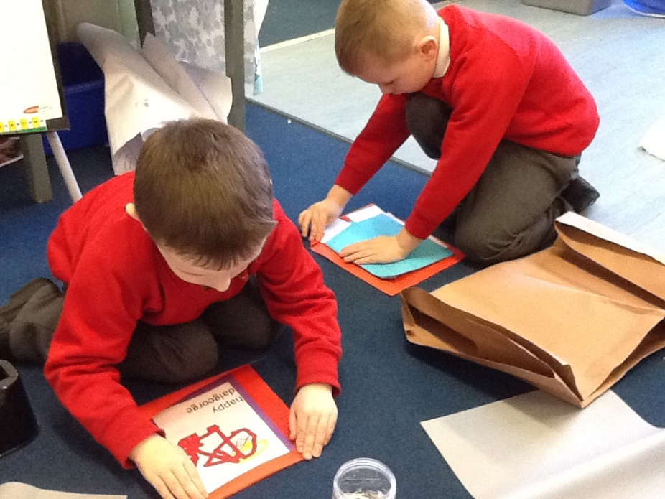
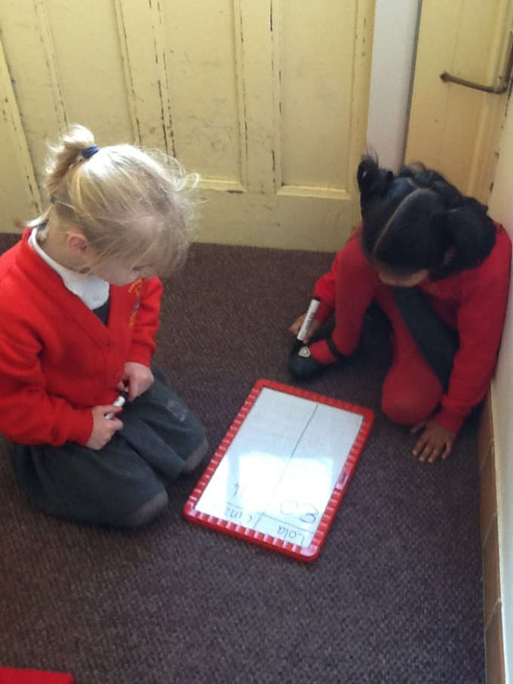
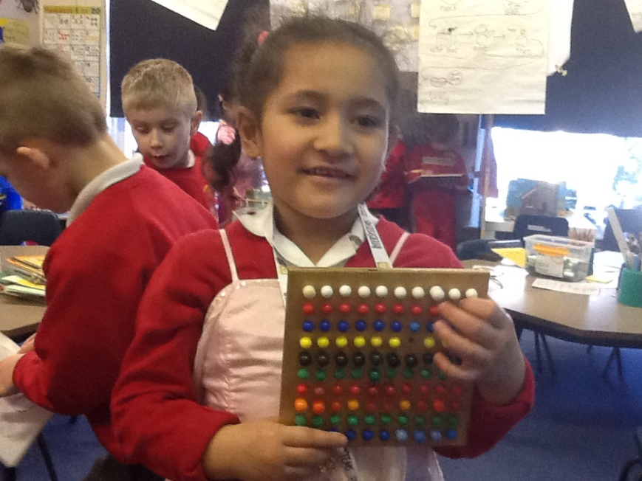
Mathematics
Within Mathematics is
Number
Numerical Patterns

Slide 9
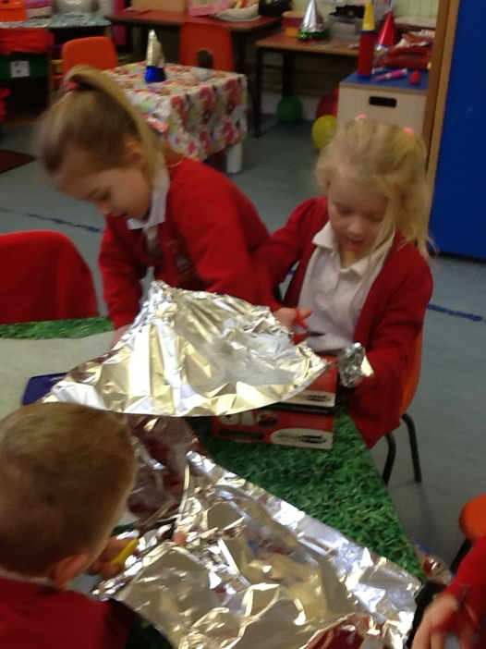
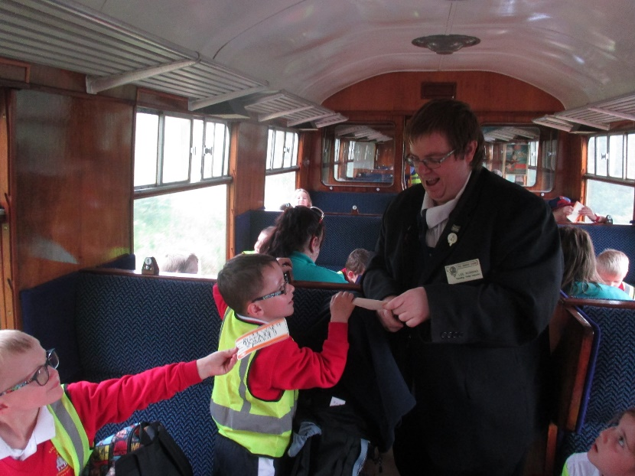
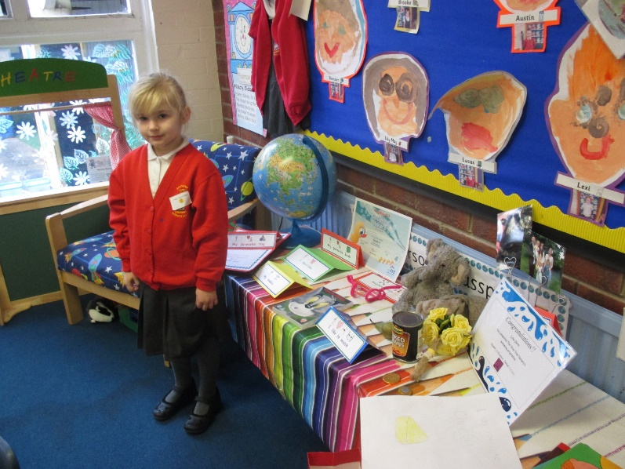
The World
Within Understanding of the World there are 3 areas
People, Culture and Communities
Past and Present
The Natural World

Slide 10
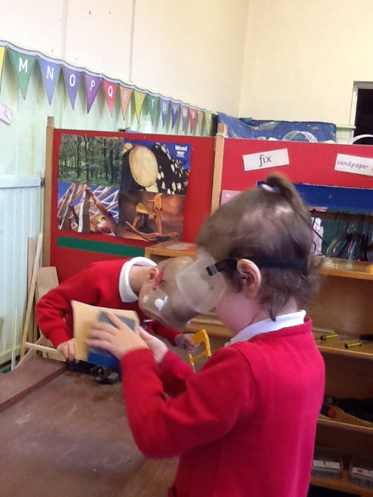
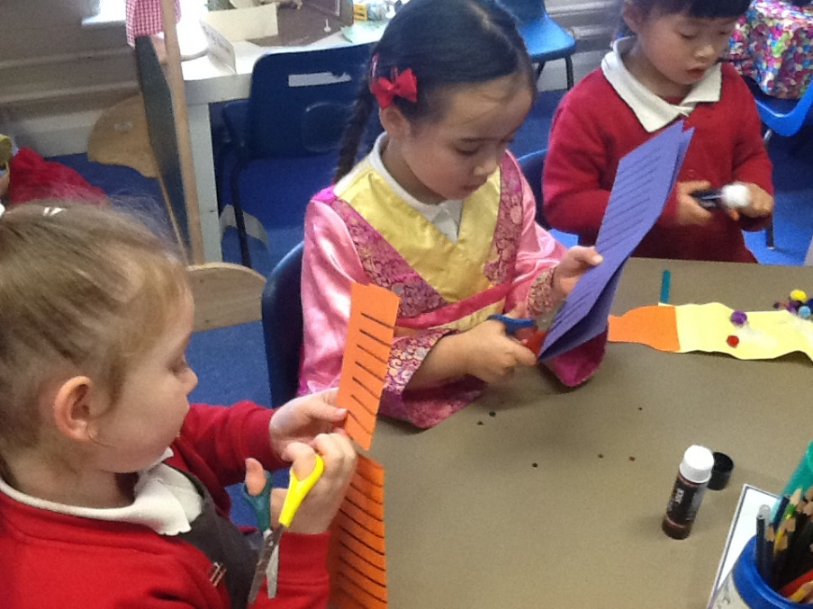
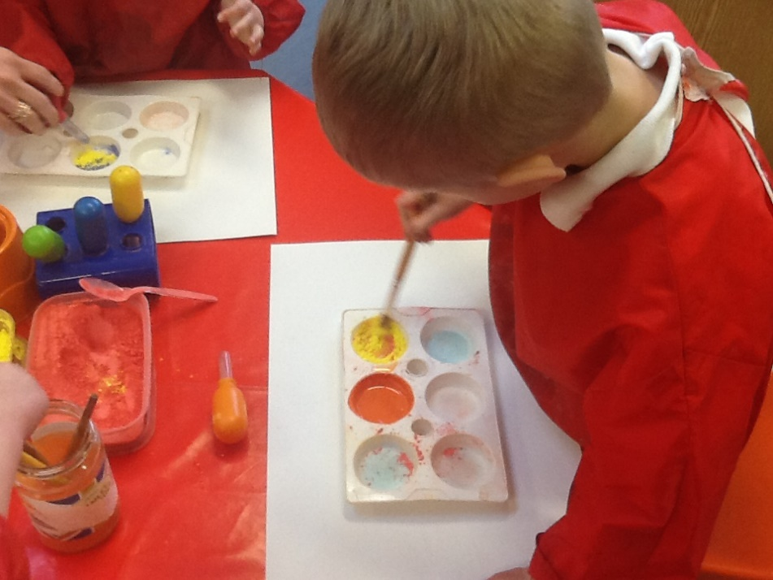
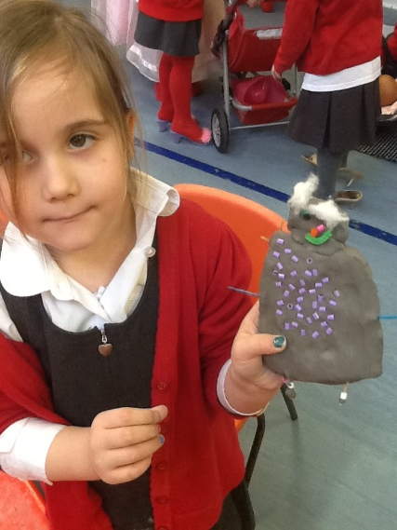
Expressive Arts and Design
Within Expressive Arts and Design are 2 areas
Being imaginative and Expressive
Creating with Materials

Slide 11
Workshops for Parents
Reading workshop – today
Maths workshop
Writing workshop
Seesaw

