Slide 1



Foundation Stage Writing Workshop

Slide 2
Tools for writing-phonics
What is “phonetically plausible”?
E.g shooger, lighk, mik, flowr, Perse,
Children need phonic knowledge before they can write.
Children then need to be able to orally segment words in order to write them.
Start with VC words, in, up, on, as etc
Then CVC words peg, can, ham etc
Longer words with multiple sounds laptop, sandwich farmyard etc
The ‘Look and Say’ words cannot be segmented. Children need to learn how to spell these.

Slide 3
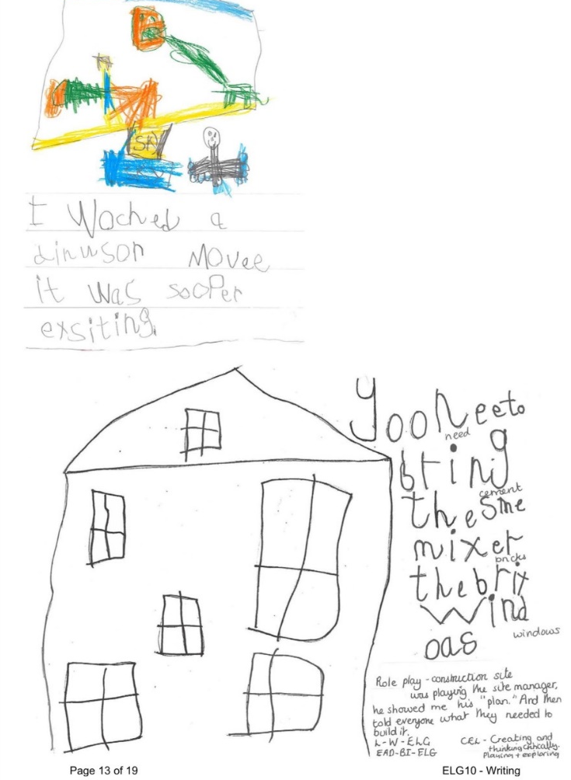
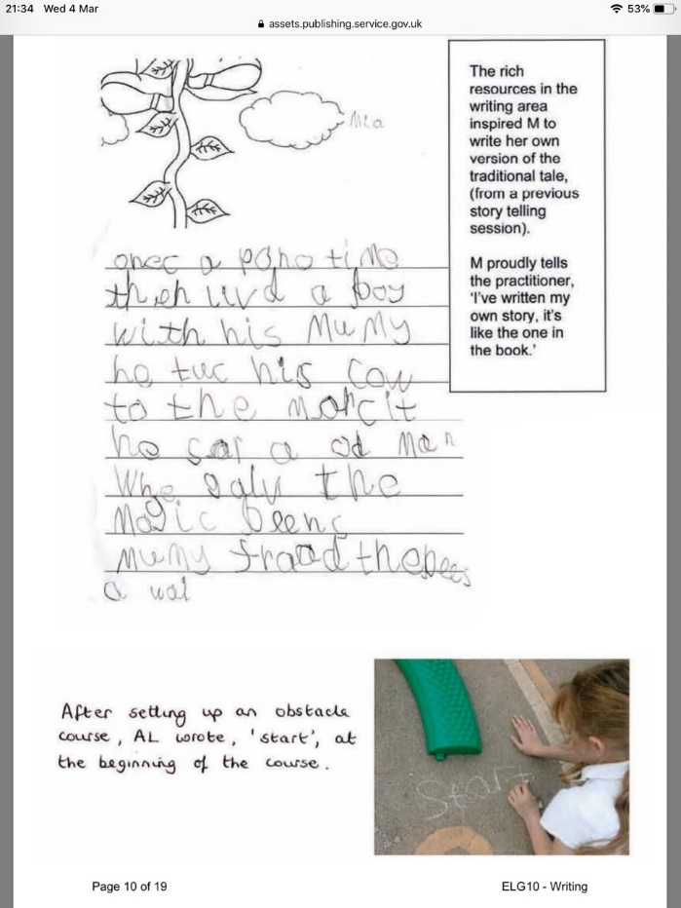
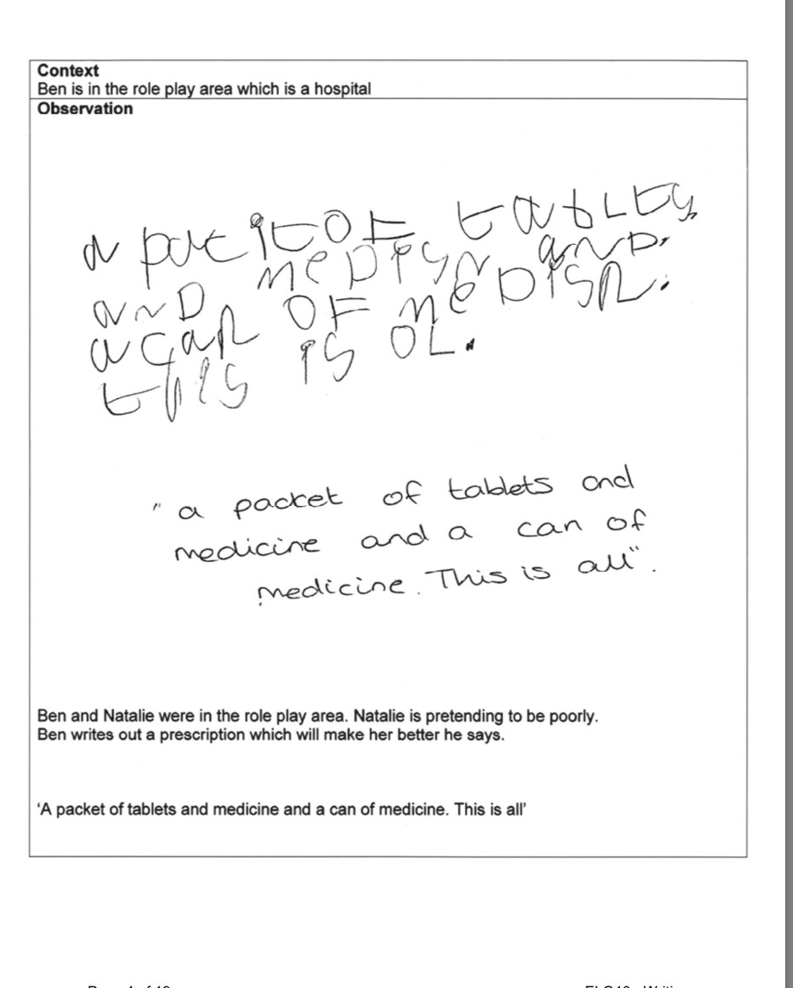
Expected level at the end of the year

Slide 4


Another tool- Physical development
ELG Children show good control and co-ordination in large and small movements. They move confidently in a range of ways, safely negotiating space. They handle equipment and tools effectively, including pencils for writing.
In order for children to be able to write they will need good gross motor skills and a strong core as research shows those children who are strong physically will become competent at writing. This is especially important in this digital age.
It is crucial children are physically strong and they need to be engaging with many different activities such as visiting parks and using the equipment, riding wheeled toys, trampolining, ball skills, swimming, climbing trees and the like.
Children who regularly participate with these activities generally have very little problems with their handwriting.

Slide 5
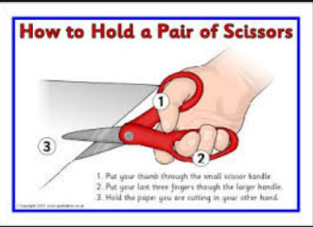
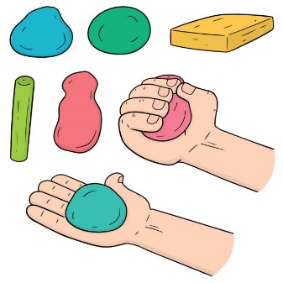

Physical Development
Good fine motor control starts at the shoulder moving to the wrist, hands then fingers.
Fine motor skills are the smaller movements normally using hands and fingers.
Using a variety of equipment not just pens/pencils etc supports the development of fine motor skills.
In school the children will have experience of using things such as scissors, play dough, threading, pegs, zips, poppers etc in our finger gym areas.
With strong able fine motor skills children soon become competent hand writers.

Slide 6
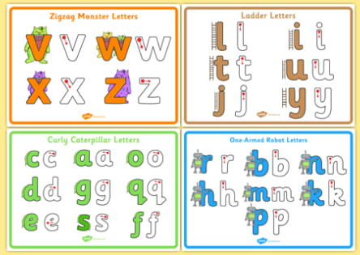
Physical
A firm tripod grip of a pencil/pen etc is crucial for writing.
The children have a daily taught handwriting lesson first thing in the morning.
Letters are taught in groups Curly Caterpillars (a c d e f g o q s), long ladders (l j t u y i), one armed robots (r m n b h k p) and zigzag monsters (v w x z)
Children also need to write capital letters and know the difference.
In English we write from left to right and the children need write on a line.

Slide 7
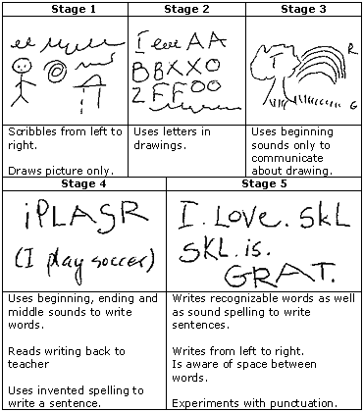
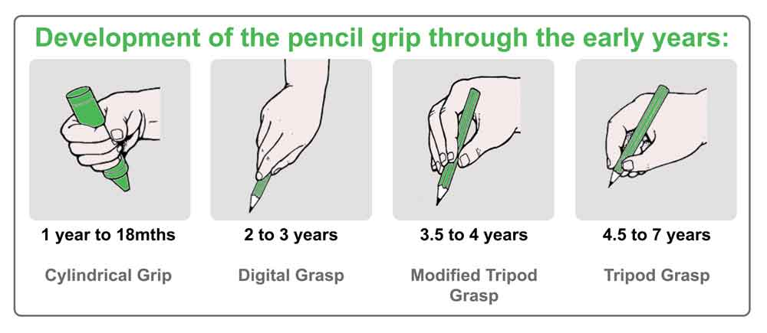
The progression of writing and holding a writing tool.

Slide 8





Handwriting

Slide 9
Writing Early Learning Goal
With good fine and gross motor skills and good phonic knowledge children will have the tools to be able to write.
They now need a reason and motivation to write (e.g. recipe book) and are taught to compose and say a word/sentence they would like to record in writing.
This then needs to be written on a line, from left to right, top to bottom.
The children are encouraged to segment a word they want to write then always re-read what they have written to know what to write next. Spaces between words help with the re-reading.
Children need to be writing independently in their play to get expected level in the Early Learning Goal, i.e not led by an adult.

Slide 10

Helping at home
Remember children need purpose and motivation to write!! So cards, invitations, shopping lists, calendars, diaries, letters, envelopes, made up books, post it messages, treasure maps, labeling etc.
Encourage your child to write their sibling names, mum, dad, nan, love, from, to etc..
Provide a variety of different resources that will encourage writing: chalk, posh pens, novelty pens, paints and brushes, stickers, highlighters, felt tips, crayons, pencils….

Slide 11


Remember to…
It is crucial that your child sees you write as much as possible especially in our digital world.
It is also critical that you read, read and read to your child in order that they have the ideas to create and write their own stories.
Praise, reward and celebrate writing. Put any examples on Seesaw for your child to celebrate.

