Slide 1

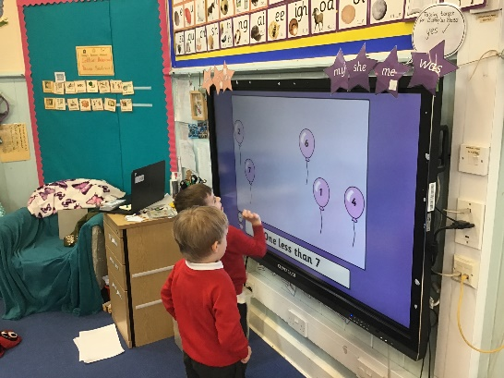
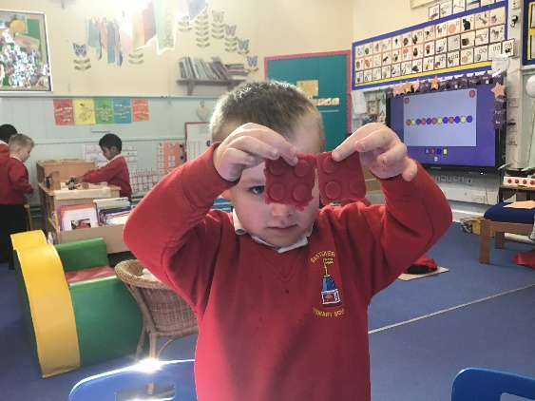
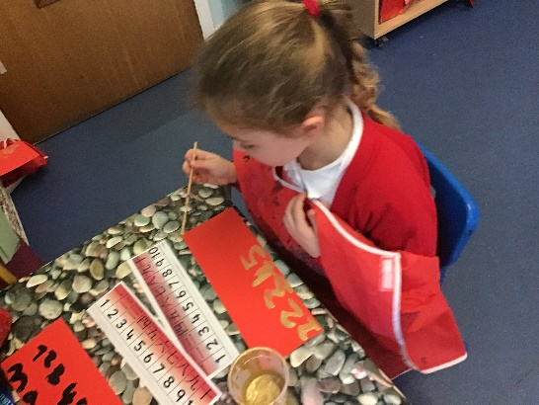
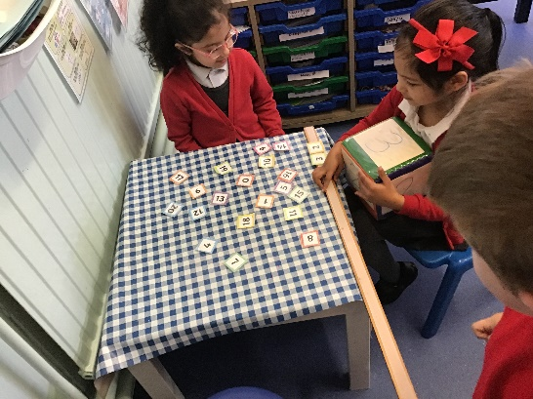
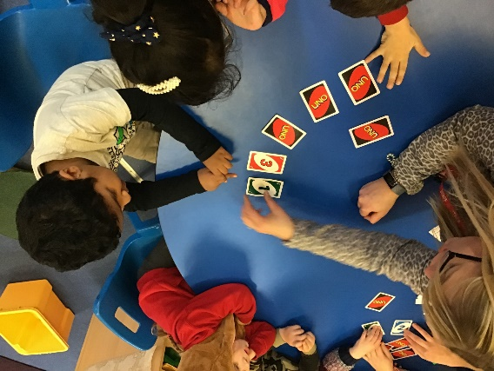
Maths at Eastover in EYFS 2021

Slide 2
Aims of the workshop
To understand how we teach number at school.
To become familiar with the language used in Maths.
How the resources help the teaching of number.
How you can help your child at home with Maths.

Slide 3
Research
What predicts success in mathematics?
We actually know a lot from research about building mathematical success in the early years, and we could do this more effectively than at present. A large scale study of pre-school experiences (Sammons et al 2002, Siraj-Blatchford et al 2002) found two key factors which predict progress:
parents providing a home learning environment, where, for instance, children were encouraged to paint, draw and play with letters and numbers
pre-school settings providing adult-led mathematics focused activities, such as number rhymes and games, alongside independent play.
We also know from research that a key focus for early mathematics is developing number sense, especially understanding number symbols, eg ‘the fiveness’ of 5. Other early predictors of success are:
  recognising numbers as dice and dominoes patterns
  comparing numbers like 5 and 7, saying which is more
  predicting the result of adding or taking away one.

Slide 4
Maths Anxieties
Research has also shown us how to create young children with negative attitudes to mathematics
creating mathematics anxiety blocks working memory space and prevents learning (Maloney et al, 2013). If children have not developed secure number concepts they are likely to be anxious about arithmetic.
children with ‘fixed mindsets’ who believe they are naturally no good at mathematics are less successful than those who have a ‘growth mindset’ and believe they can learn through effort (Dweck, 2006). We are encouraging a growth mindset with the children!
mathematics anxiety is also created by anxious parents “I was never any good at Maths.”

Slide 5
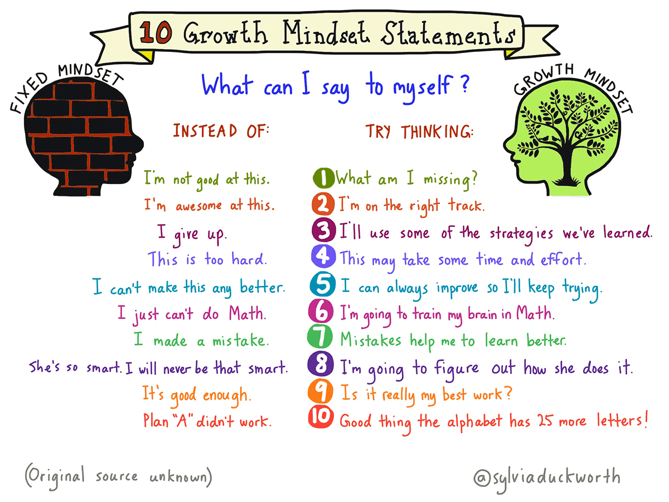

Slide 6
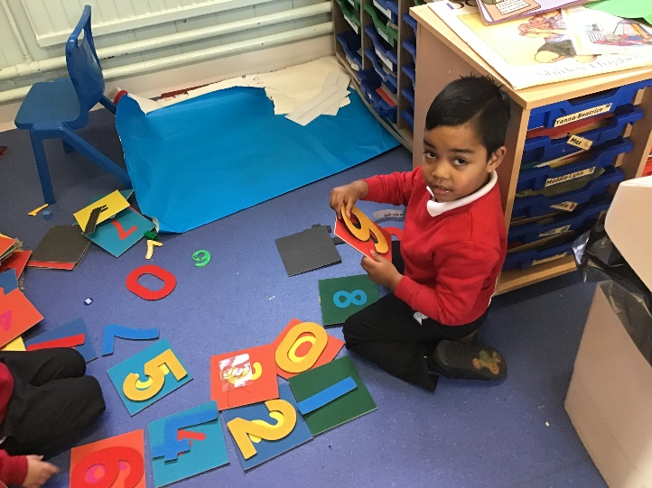

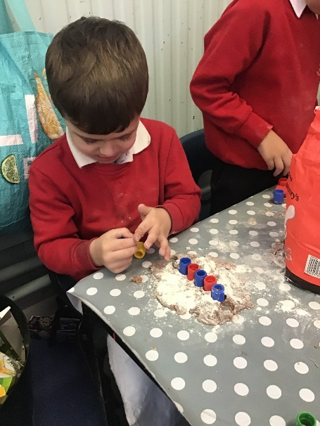
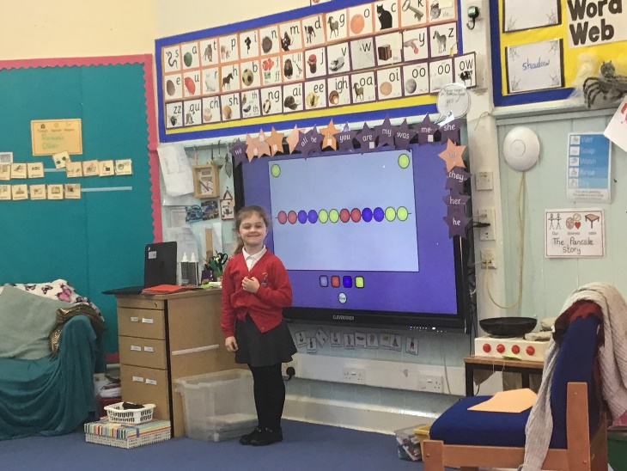
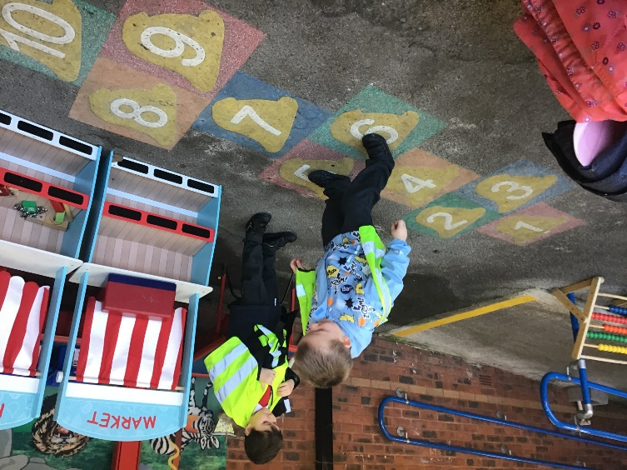
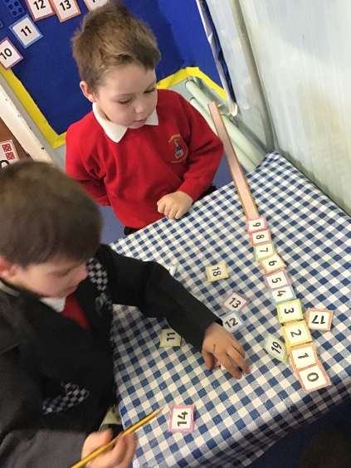
Maths at Eastover

Slide 7
Maths Curriculum in FS
Developing a strong grounding in number is essential so that all children develop the necessary building blocks to excel mathematically. Children should be able to count confidently, develop a deep understanding of the numbers to 10, the relationships between them and the patterns within those numbers. By providing frequent and varied opportunities to build and apply this understanding - such as using manipulatives, including small pebbles and tens frames for organising counting - children will develop a secure base of knowledge and vocabulary from which mastery of mathematics is built. In addition, it is important that the curriculum includes rich opportunities for children to develop their spatial reasoning skills across all areas of mathematics including shape, space and measures. It is important that children develop positive attitudes and interests in mathematics, look for patterns and relationships, spot connections, ‘have a go’, talk to adults and peers about what they notice and not be afraid to make mistakes.
The Early Learning Goals in Maths are:
Number
Numerical Patterns

Slide 8
Early Learning Goal in Number:
This is what the children are expected to achieve by the end of the year:
Have a deep understanding of number to 10, including the composition of each number;
Subitise (recognise quantities without counting) up to 5;
Automatically recall (without reference to rhymes, counting or other aids) number bonds up to 5 (including subtraction facts) and some number bonds to 10, including double facts.

Slide 9
Early Learning Goal in Numerical Patterns:
This is what the children are expected to achieve by the end of the year:
Verbally count beyond 20, recognising the pattern of the counting system;
Compare quantities up to 10 in different contexts, recognising when one quantity is greater than, less than or the same as the other quantity;
Explore and represent patterns within numbers up to 10, including evens and odds, double facts and how quantities can be distributed equally.

Slide 10
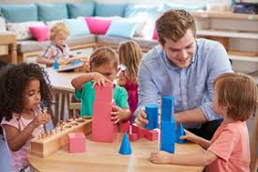
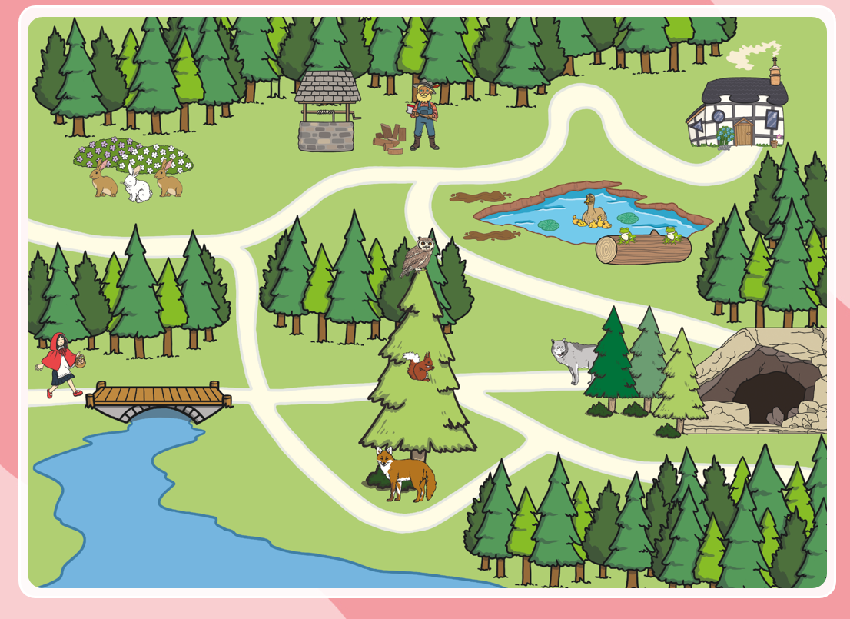
SPATIAL reasoning
Spatial Reasoning is all about how we understand the way things move in relation to the space around us
It’s a crucial skill for children to learn, but it’s also really important for a child’s later mathematical development.
Understanding relationships: – How things fit together, and how moving parts work
Language: – Hearing, describing, directing position and direction
Spatial memory: – Remembering where things are
Sense of direction: – Noticing where you’re going, and finding your way back
Spatial representations: – Creating mental images, understanding perspective and movements, reading models and diagrams

Slide 11
Mastery teaching
New curriculum in 2014
Children should become fluent, be able to reason and solve problems.
Enables children to have a deeper understanding of mathematical concepts.

Slide 12


Three stages
Concrete: Children physically line up ducks in a row and verbally label them, e.g. ‘first /second / third.’ | Pictorial: Children order slides with pictures of ducks, for example, on the Interactive Whiteboard. | Abstract: Children apply their understanding of ordinal numbers, e.g. by using written 1st, 2nd and 3rd labels and other related verbal language when ordering objects. 3

Slide 13
Number sense
Becoming familiar with each number.
Being able to pull the numbers apart up to 10 and put them back together
Representing amounts in different ways

Slide 14
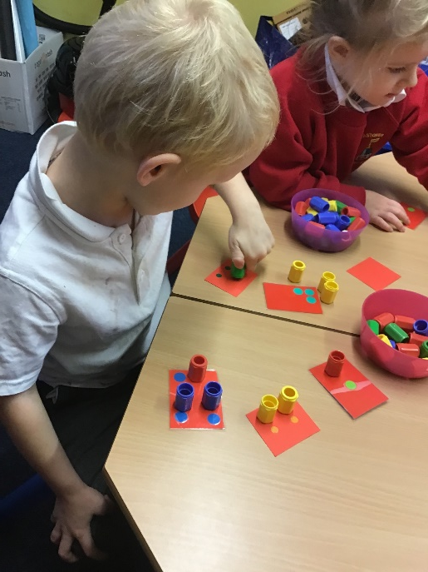
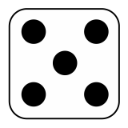
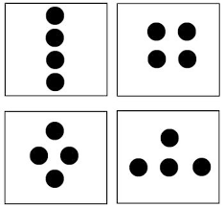

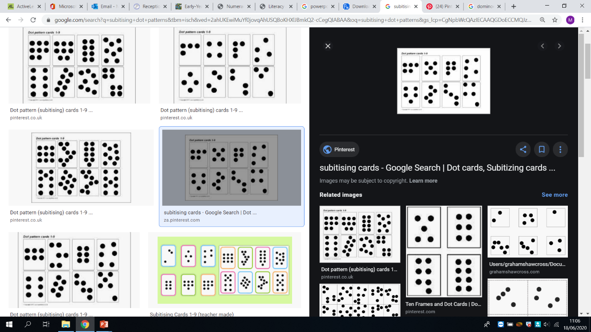
Subitising
Nurture children’s number sense by developing subitising which means to be able to recognise numbers in small groups without the need for counting.

Slide 15
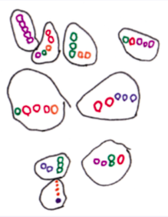
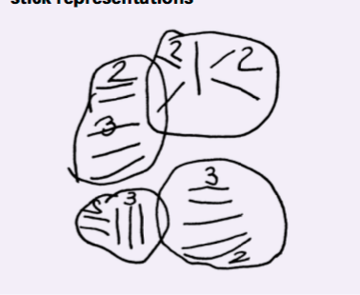
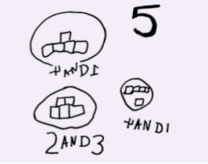
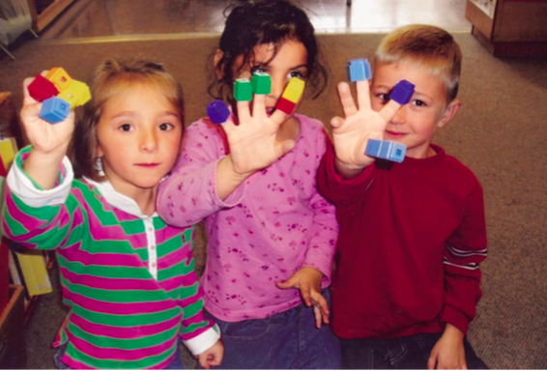
Representing numbers in different ways
All these ways represent 5.
What is 5 and what is not 5?
Can the children explain?

Slide 16
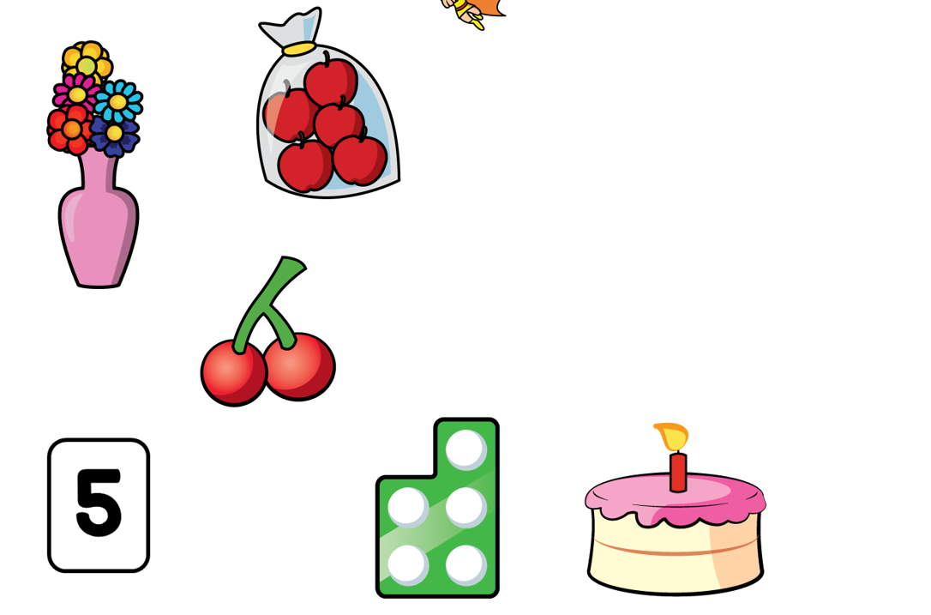
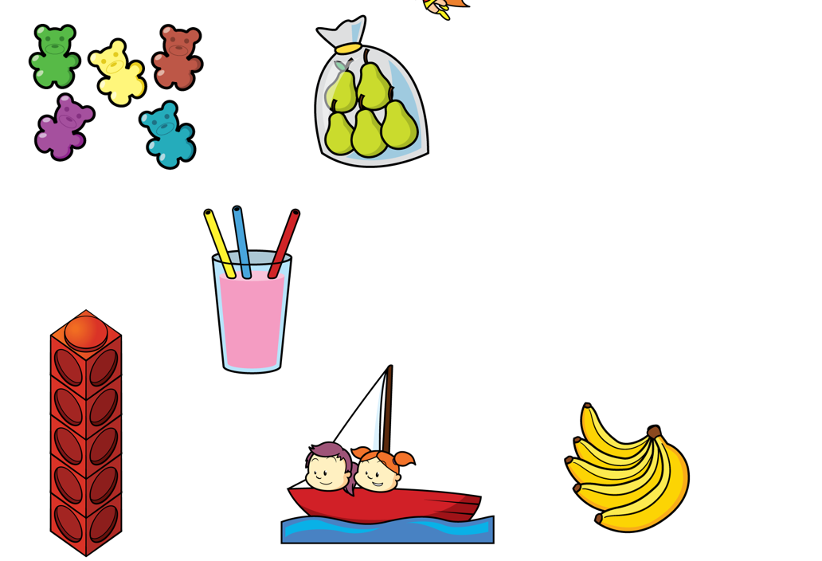
5 or not 5?

Slide 17
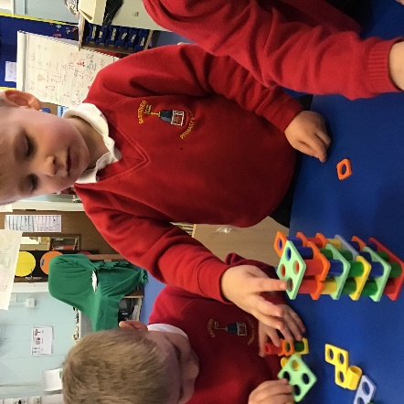
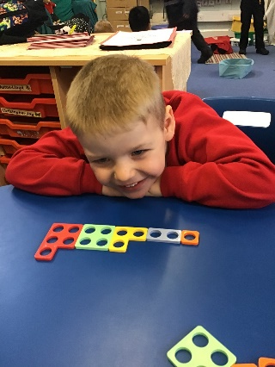
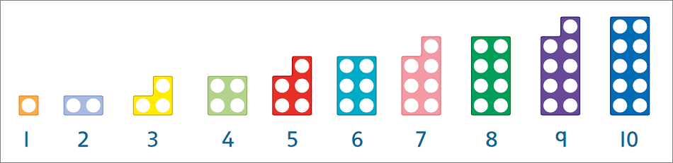
Numicon
In school we use Numicon to support children to develop a sense of number.
It is a concrete resource that children can manipulate.
We use Numicon to match the corresponding numerals to the correct plates
Subitising
Finding the matching pair
Counting accurately
Weighing them
Ordering them
Finding one more and one less
Place value tens and ones – teen numbers understanding 1 represents 1 group of 10

Slide 18
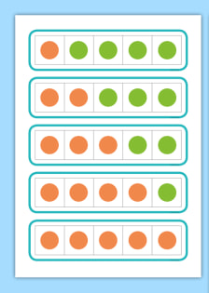
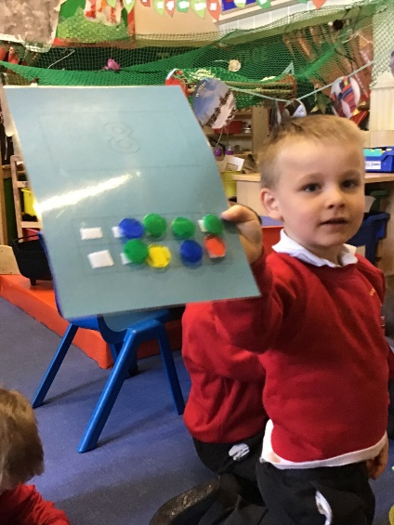
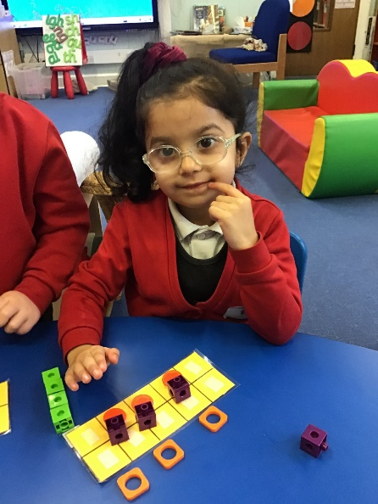
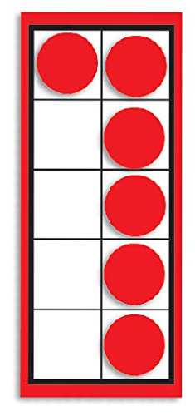
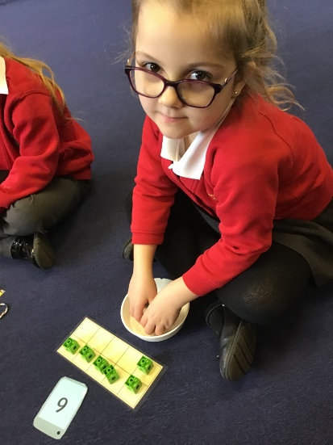
Five frame and ten frame
They can be used in many ways.
To represent a number in different ways.
To make pairs of numbers.
To add and subtract numbers.
A way of representing numbers in different ways.
When children are confident in using a five frame they will move to a tens frame.

Slide 19
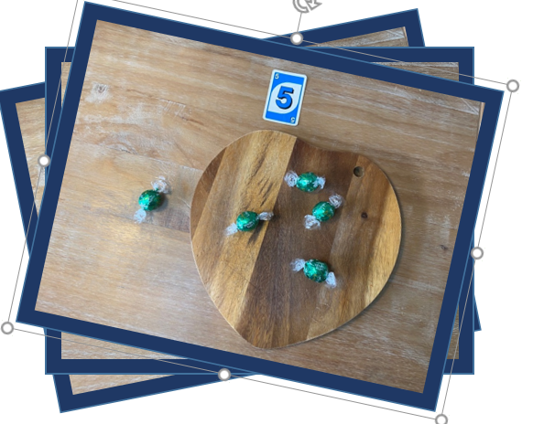
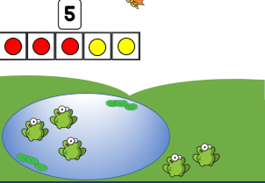
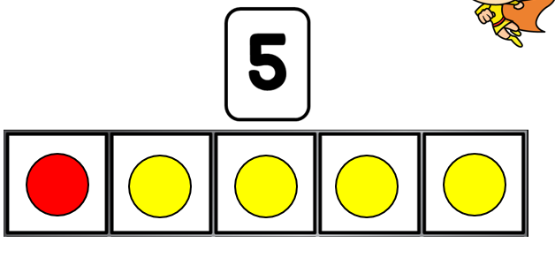

Slide 20
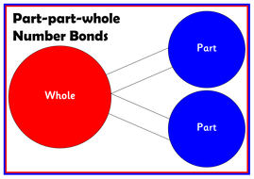
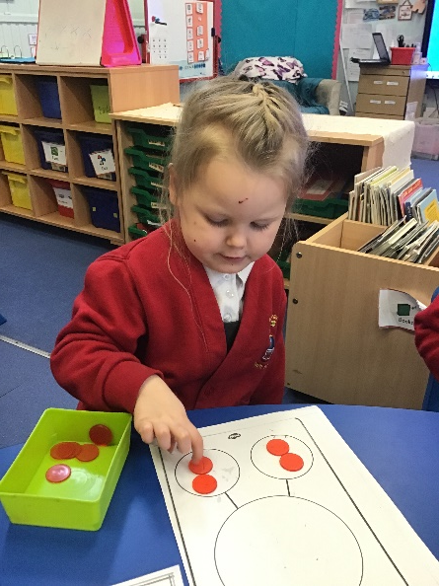
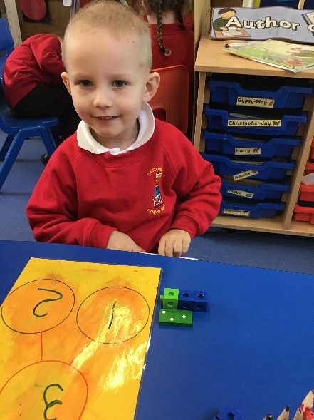
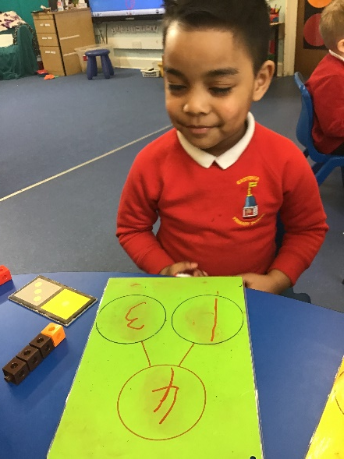
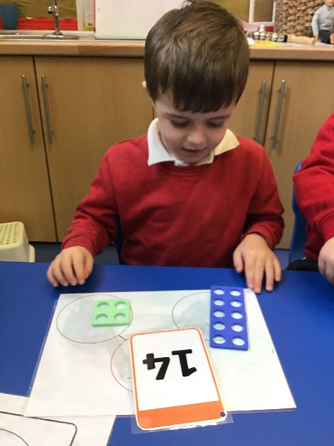
Part Part Whole
Represents the number in different ways.
The whole can be split into 2 or more parts.
The parts go together to make the whole.
The basis of adding and subtracting

Slide 21
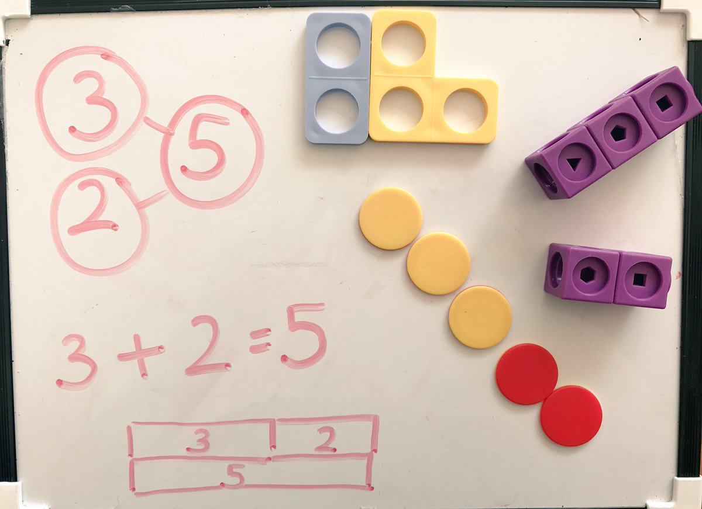

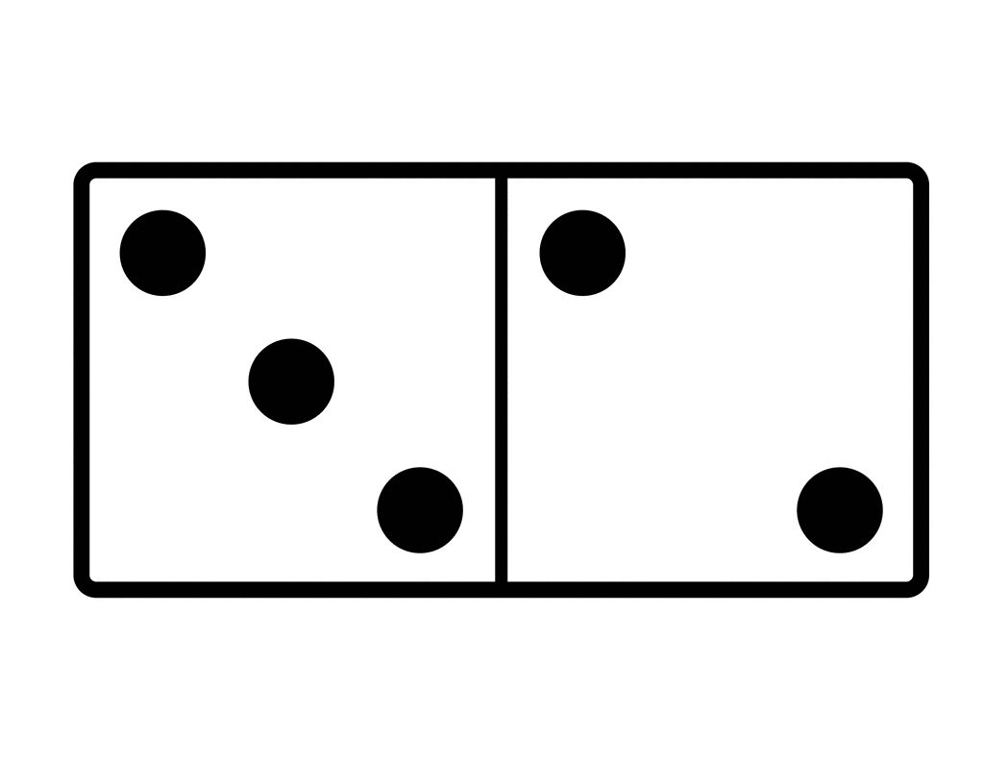

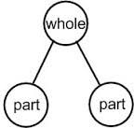



Part Part Whole
Solve… 4 + 3 =
Model
3
?
4

Slide 22
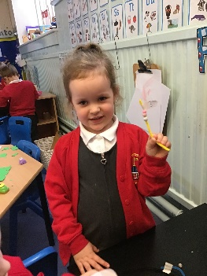
Reliable accurate counting
In order for children to have a good understanding of number they need to be able to count reliably and consistently.
Recite numbers in order, from different points.
Counting objects that can be moved- move them to support counting.
Counting something that can’t be moved (sounds, pictures).
Subitising.
Knowing that the number they stop on is, is how many in that group.

Slide 23
Asking Maths questions
How do you know?
What is the same?
What is different?
What comes in the middle, next, before, after?
What do you notice?
What if…..?
Can you show me in a different way?

Slide 24
True or false
We also encourage the children to reason by saying if a statement is true or false and how they know.
True or false – 4 is less than 2?
Possible answer- false 4 is more than 2, we can make 4 with 2 and 2.
True or false – 3 is the same as 2 + 1
True – when you add 2 and 1 together the answer you get is 3.

Slide 25
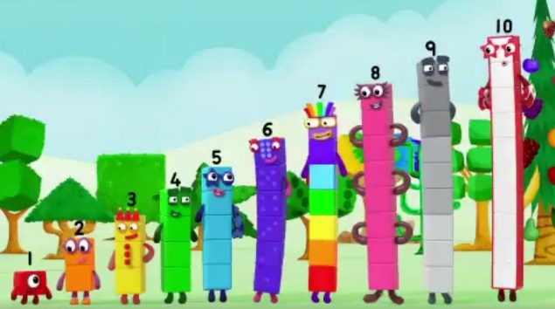
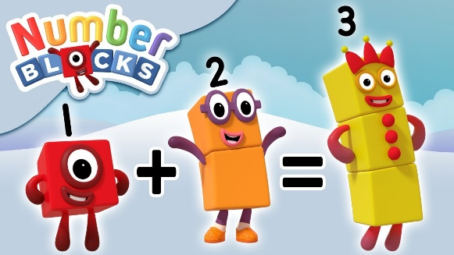
Numberblocks
We use Numberblocks to help embed secure number sense.
Children watch the clip relating to the number and then explore the number through a variety of resources.
Numberblocks models splitting and combining numbers to solve problems.
Images and abstract number equations (sentences) are presented together to help children connect the concrete and abstract.

Slide 26
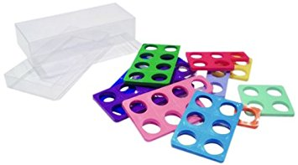
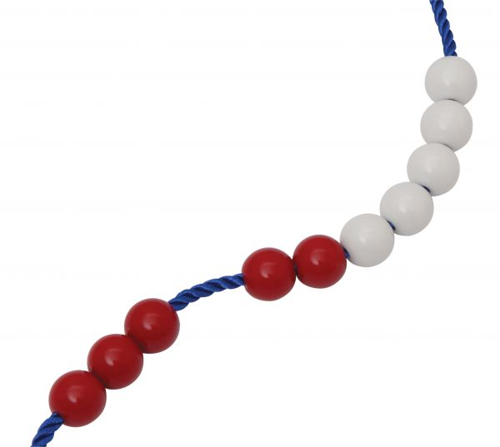
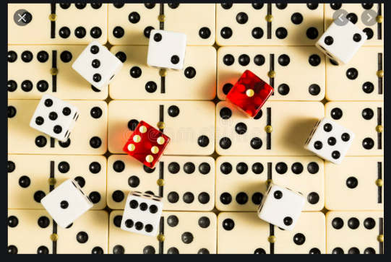
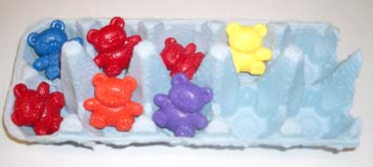
Resources we use
Numicon
Numberline
Pop cubes
Ten frame
Egg boxes
Dominoes
Dice
Bead strings
Ice cube trays
Plates
Bundles of straws

Slide 27

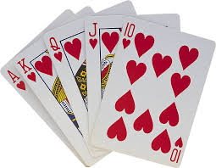


What can you do at home?
Have fun!
Don’t be afraid of Maths- ask if you are unsure
Children need to have rich mathematical experiences at home
Play games- domines, counting, pairs, snap, UNO, board games
Singing number songs- 5 little ducks, 10 green bottles
Practical maths – counting items into a shopping basket, adding small quantities of coins together, sharing toy food at a teddy bear’s picnic etc.
Play should include opportunities for size, shape, capacity, number and simple addition and subtraction vocabulary.
Online games exploring number, shape and more!
Playing I spy whilst on walks out and about – which shapes or numbers can you see? Number plates, numbers on buses etc are great for this.
Baking – support your child in reading numbers for ingredients, counting spoon fulls into a bowl, timing the baking of cakes etc.

Slide 28
Websites that can support early Maths
https://www.topmarks.co.uk/Search.aspx?Subject=16&AgeGroup=1
https://www.bbc.co.uk/cbeebies/topics/numeracy
http://www.crickweb.co.uk/Early-Years.html
Numberblocks

Slide 29

Thank you for listening
Any questions?

