Slide 1

Welcome to Year 5

Slide 2
Attendance
Gates open at 8:35
School registration is at 8:45
Pick up at 15:10.
Parental permission can be given to allow children to walk home independently.
Phones can be brought in, held by teachers until the end of the day.

Slide 3
Uniform
All clothing should be clearly marked with your child’s name.
🧥 School Uniform | ⚽ PE Kit
🔴 Red sweatshirt or cardigan | 🔴 Plain red T-shirt
⚪ White polo shirt | ⚫ Plain black shorts or tracksuit bottoms
⚫ Grey trousers, shorts or skirt | 👟 Suitable trainers
🧦 Black or grey tights (with skirts) | 👟 Sports footwear (e.g. football boots when needed)
👞 Plain black school shoes (no trainers)

Slide 4
Accessories
⌚ Smart, sensible watch
💎 One pair of stud earrings only
🎒 School book bag (provided on admission)
💇 Appearance
Hair should be neat and suitable for school.
Long hair must be tied back for PE and practical activities.
No brightly coloured hair.
No excessive hair accessories.
❌ Not Permitted
👟 Trainers as everyday school shoes
👖 Black jeans
👠 High heels (block heels up to 3cm only)
💍 Jewellery other than one pair of stud earrings and a watch
🎀 Bold patterned or brightly coloured headwear

Slide 5
Homework expectations
Emile: complete task set
Reading: 10 minutes x 4 and recording in their Reading Record.
Reading records to be brought in daily.
Passwords will be sent home.

Slide 6
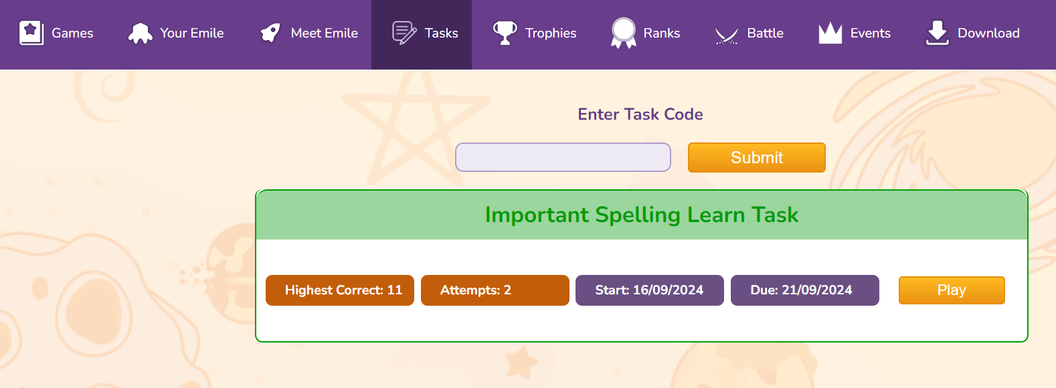
Emile
Children are set a new task every week, this needs to be practiced
everyday as these are the week’s spellings.

Slide 7
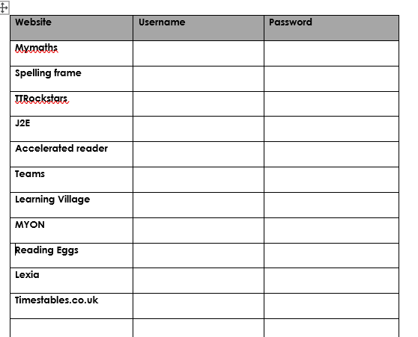
Passwords
All passwords will be sent home.

Slide 8
Website:
https://www.eastoverschool.co.uk/
All links to the curriculum and children’s learning can be found on the school website in ‘key information – curriculum’:
There is also Year 5 information on the ‘class pages’ section

Slide 9
Communication
white boards outside the classrooms
school bulletin each Friday
reading records
Facebook
school website – www.eastoverschool.co.uk
Email:
llukins@eastoverschool.co.uk
cthorne@eastoverschool.co.uk
Talk to us at the end of the school day
Call the office and ask us to call you

Slide 10
Any questions?

