Slide 1

Welcome to Year 4

Slide 2
Attendance
Gates open at 8:35
School starts at 8:45
No authorised holidays unless exceptional circumstances.

Slide 3
Item | Optional or required | How to acquire
Red sweatshirt or Red cardigan | Required | Branded sweatshirt and cardigan available from school suppliers and second hand from online school uniform platform. Red sweatshirt or cardigan can be bought from regular retailers.
White polo shirt | Required | Available from school supplier, second hand from school uniform platform and available from regular retailers.
Grey trousers, shorts or grey skirt, | Required | Available from school supplier, second hand from school uniform platform and available from regular retailers.
Sensible, plain black shoes | Required | Available from regular retailers.
Plain red t-shirt | Required | Available from regular retailers.
Plain black shorts | Required | Available from regular retailers.
School book bag | Provided by school on Admission | Available from school supplier.
Please ensure all items are named!

Slide 4
PE kit
Children have PE on Tuesdays.
Plain T-shirt with no branding
Plain shorts or tracksuit bottoms with no branding
Suitable trainers
Suitable sports footwear, e.g. football boots

Slide 5
Jewellery
Permitted jewellery that may be worn is:
One pair of stud earrings – no other piercings are permitted.
A smart and sensible wrist watch.
Jewellery is the responsibility of the pupil and not the school. Lost or damaged items will not be refunded.
All jewellery must be removed during practical lessons, including PE lessons and science experiments.
Hairstyles
The school reserves the right to make a judgement on where pupils’ hairstyles or hair colours are inappropriate for the school environment; however, will ensure that any such judgements do not discriminate against any pupil by virtue of their protected characteristics. Each individual pupil’s scenario will be taken into account where any judgements on appropriateness are to be made, and parents will always have the freedom to complain via the school’s Complaints Procedures Policy.
Pupils with long hair must ensure that this does not impede their vision, cover their face or provide a health and safety risk. Long hair must be tied up during practical lessons, e.g. during PE.
The following hairstyles are not considered appropriate for school:
Brightly-coloured, dyed hair.
Headwear with bold patterns or colours.
Excessive hair accessories.

Slide 6
Swimming
We will be swimming from Monday 19th October- Monday 30th November (block 1).
Then again from Monday 8th February-Monday 22nd March (block 2).
Children need to wear PE kit on these days
Swimming kit
Towel
Goggles if possible
Named

Slide 7
Homework expectations
We expect the children to read daily
Homework should be a mixture of reading, spellings (Emile) and times tables (TT Rockstars).
10 mins for each.
All reading should be recorded in the child’s homework diary. Please write the page numbers read and sign.

Slide 8


How to support your child with reading
Enjoy books together.
Share favourite stories, comic, non-fiction or magazines. Discuss what happened in the text or what you think could happen. Try and make reading a part of your day.

Slide 9
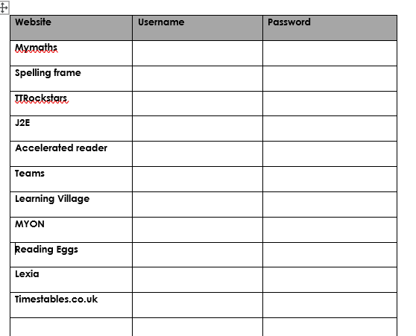
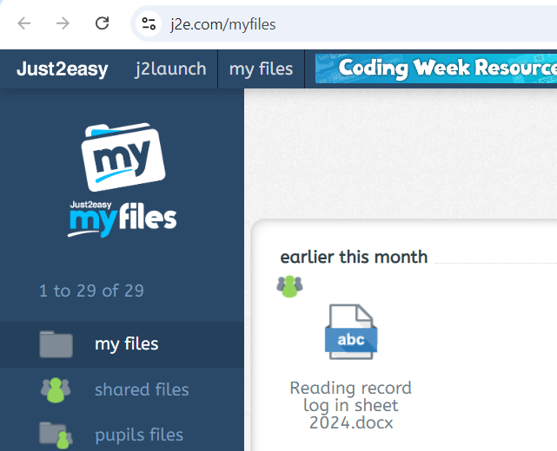
Passwords
All passwords will be in reading records.
Also on J2E.

Slide 10
Curriculum
All links to the curriculum, knowledge organisers and children’s learning can be found on Seals and Dolphins class page.

Slide 11

Residential 2027 – Barton Hall, Devon
B

Slide 12
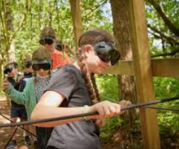

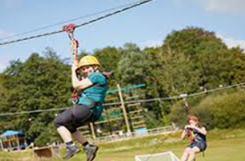
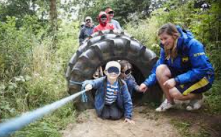
Visiting Barton Hall for your school trip is an opportunity to learn through real outdoor adventures. It is all designed to keep your child active, engaged, and excited from start to finish.

Slide 13
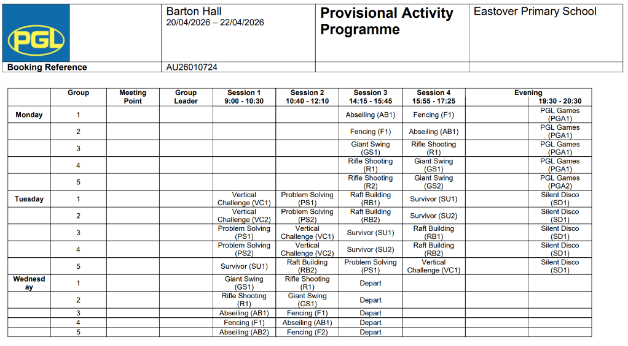
Activities
https://schoolsandgroups.pgl.co.uk/centres/barton-hall/

Slide 14
Communication
white boards outside the classrooms
school bulletin each Friday
reading records
Facebook
school website – class pages: https://www.eastoverschool.co.uk/page/?title=Year+4+%2D+Seal+%26amp%3B+Dolphin+class&pid=95
Email: mpierzchalska@eastoverschool.co.uk
jfleet@eastoverschool.co.uk
Talk to us at the end of the school day
Call the office and ask us to call you

Slide 15
Thank you for coming!

