Slide 1
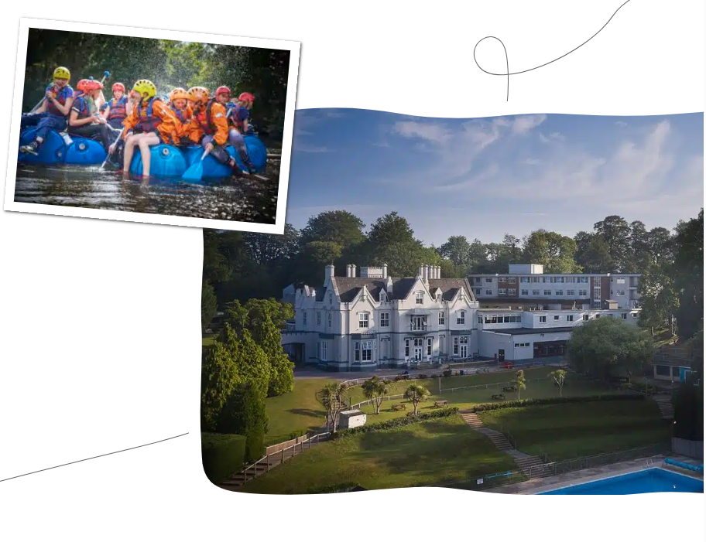
Residential 2026 – Barton Hall, Devon
B

Slide 2
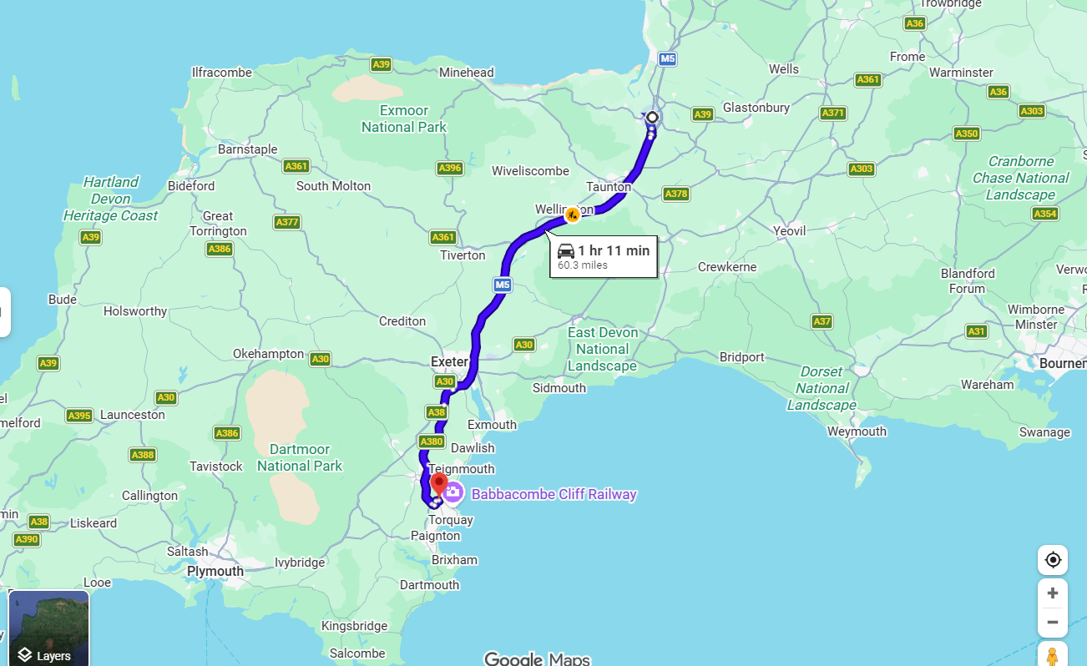
As you know, the children in Year 4 are offered the opportunity to take part in a residential trip. This year, we are very excited to use the facilities at Barton Hall.

Slide 3
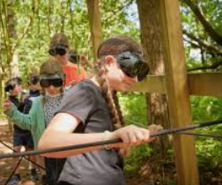
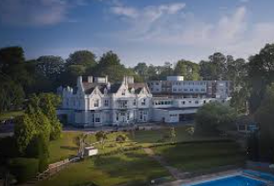
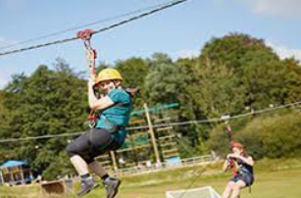
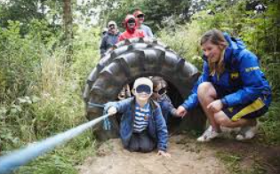
Visiting Barton Hall for your school trip is an opportunity to learn through real outdoor adventures. It is all designed to keep your child active, engaged, and excited from start to finish.

Slide 4
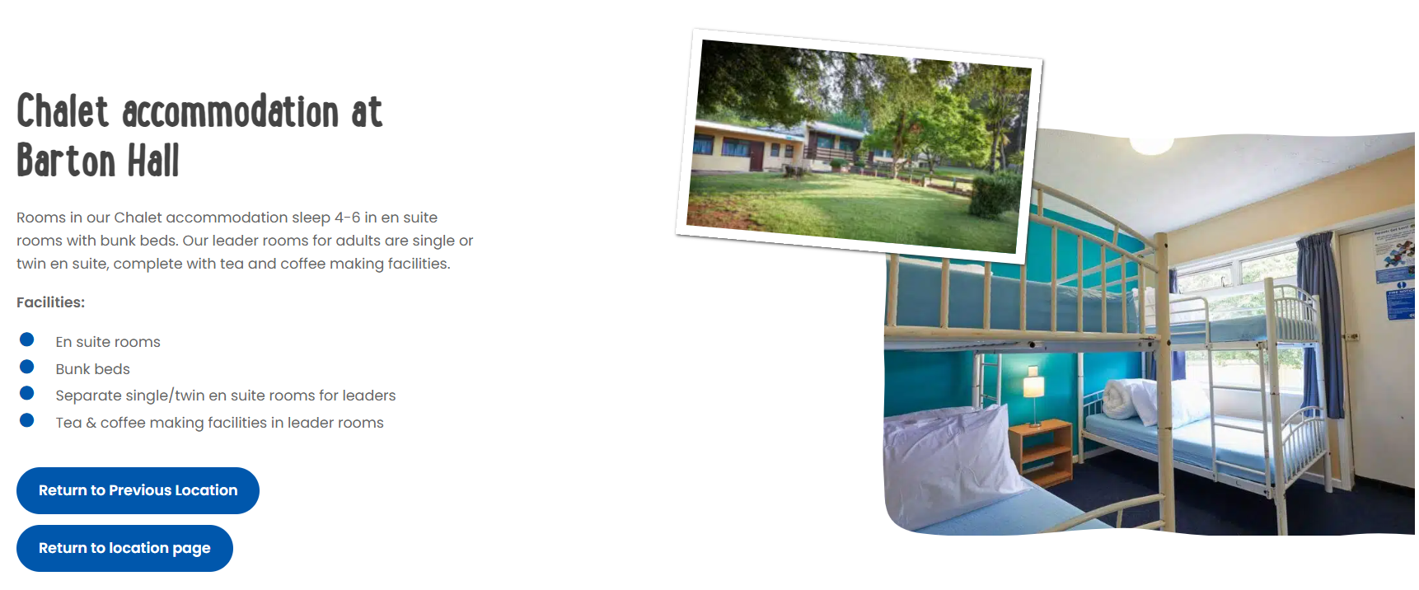
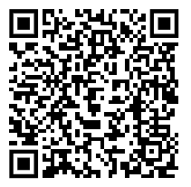
Accommodation
More information on a website:
https://schoolsandgroups.pgl.co.uk/centres/barton-hall/?utm_source=gmb&utm_medium=organic&utm_content=gmbbartonhall

Slide 5
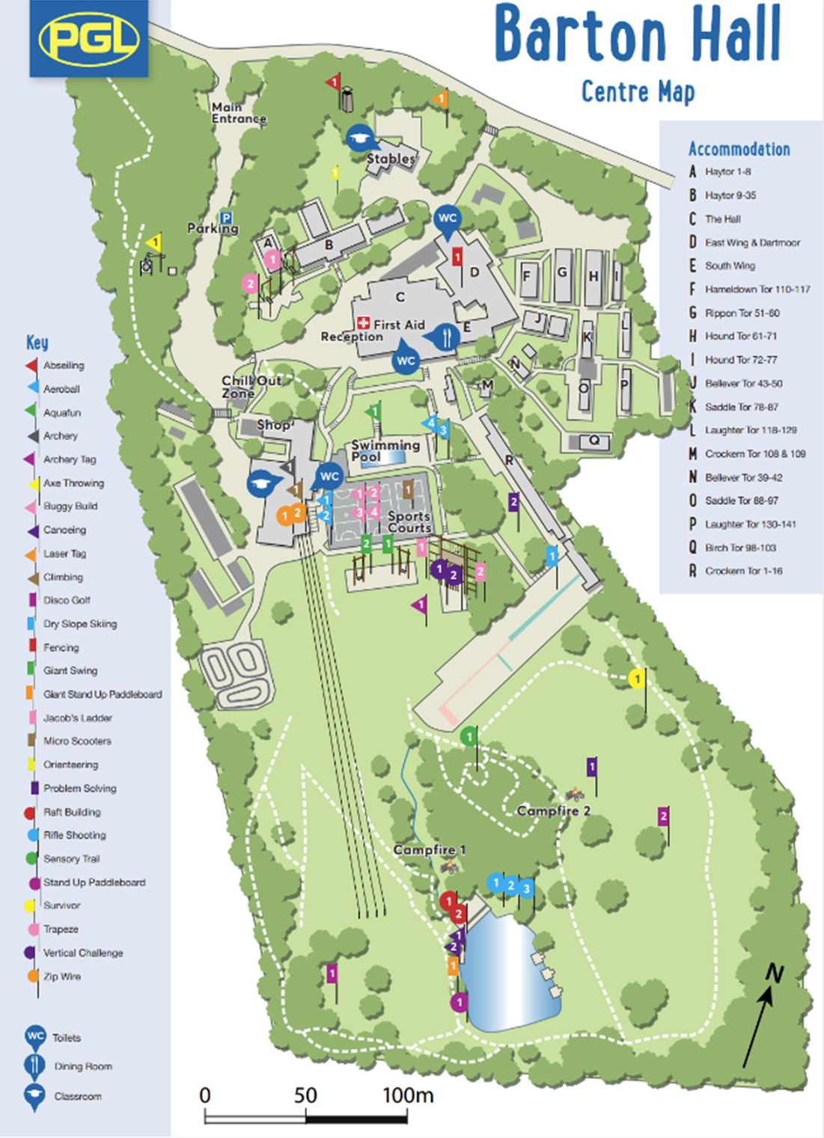
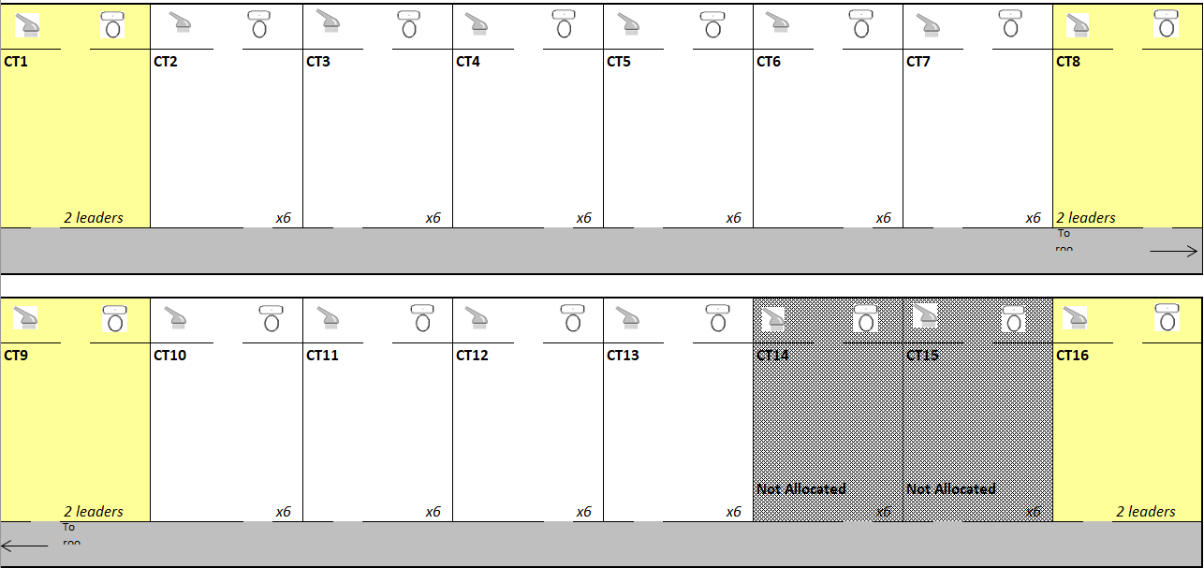

Slide 6
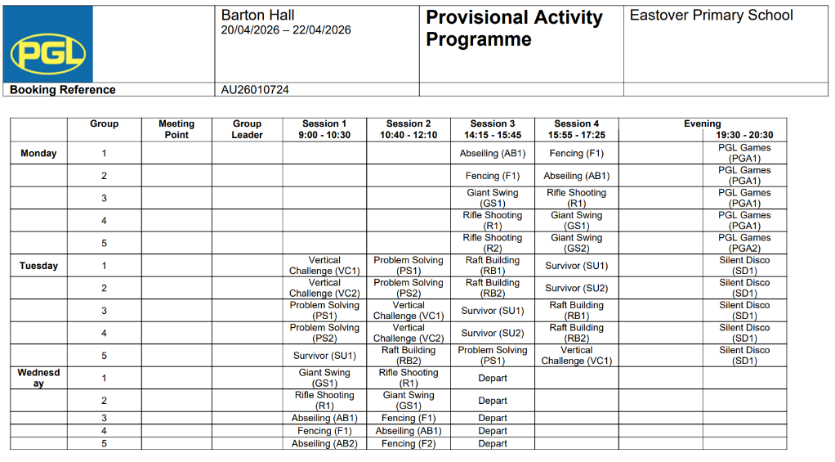
Activities
https://schoolsandgroups.pgl.co.uk/centres/barton-hall/

Slide 7
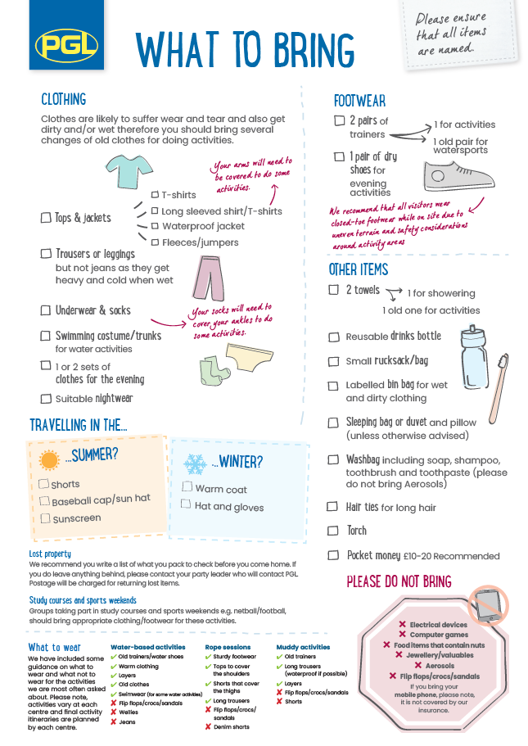
Please provide your child with a packed lunch on Monday 25th September.
No devices.

Slide 8

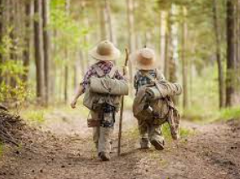
On Monday 20th April we would like children to be in school at 8:35 am in their own clothes. We are leaving in the morning and arrive at 12:00. The children will have their packed lunch upon arrival. We are planning lots of activities throughout our stay, with the first session being Monday afternoon to last session finishing on Wednesday after lunchtime. We aim to arrive back at school around 3:30pm Wednesday afternoon.

Slide 9
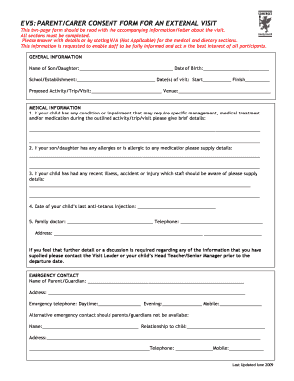
EV5

Slide 10
Questions

